Slide 1

International Youth Robot Competition (IYRC) 2026
KOREA
RULES & REGULATIONS
Version 1.2

Slide 2
Overview
Date: 6th & 7th August 2026
Venue: Hanbat National University, Korea
Organizer: International Youth Robotics Committee (IYRA)
Co-organizer:
Participants: More than 2,000 participants from 30 countries around the world.

Slide 3
Competition Categories
Kinder (below 8 years old) – by birth year 2018
1. Robot Bowling (Kinder Skill)
2. Math Challenge (Kinder Skill)
3. Young Innovators
Junior (8-13 years old) – by birth year 2011
1. Animal Kingdom (Junior Coding)
2. Math Challenge (Junior Skill)
3. Push-push (Junior Skill)
4. Soccer (Junior Skill）
5. Communication Master III
6. Wandering Planet III
Senior (13-18 years old) – by birth year 2008
1. Eco-Restoration (Senior Coding)
2. Robot Volleyball (Senior Skill)
3. Autonomous Push-push (Senior Coding Skill)
4. Wandering Planet III
Compulsory (Junior + Senior)
1. Creative Robot Design – “Jurassic Intelligence X AI Innovation”
Open
1. Humanoid Robot Mission
2. Genibot Coding Mission
3. Game Maker Kit Game Challenge
4. Drone Soccer
5. Drone Mission
6. Cocomon GO

Slide 4
KINDER CATEGORY
Robot Bowling
Math Challenge
Young Innovators

Slide 5
KINDER : ROBOT BOWLING
Age | < 8
Category | Individual Mission
Robot Kits Allowed | GOMA & BRAIN
Mission | Throw ball to knock down pins from start box
Robot Building | Pre-build & on the spot Card Programming

Slide 6
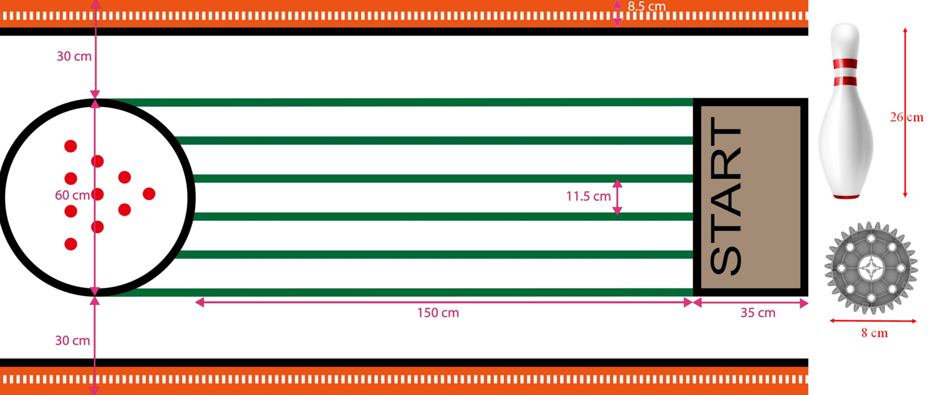
ROBOT BOWLING GAME FIELD

Slide 7
ROBOT BOWLING GAME RULES
Dimensions & Restrictions
Initial size shall not exceed 35cm (H) X 35cm (W) X 35cm (L).
Robots are allowed to expand to any size after the game starts
Robots are Strictly NOT ALLOWED to have any foreign parts (including rubber band, black tape or scotch tapes) other than the parts in GOMA & BRAIN
Robots are not allowed to have any power supply above 6V DC (Volt of Direct Current).
Game Duration
3 minutes is given from the point of receiving programming cards and reader from referee
2 rounds whereby each round will have 3 attempts to shoot, (total of 6 attempts)
Time taken to replace the pins will not be counted within the 3 minutes given

Slide 8
ROBOT BOWLING GAME RULES
Scoring
Programming : If participants are able to program the robot by themselves (10 marks)
Programming : If participants request referee’s help to program the robot (0 marks)
Shooting : 1 point for each pin knocked down
Reset of pins : Reset of pints only during the first attempt of each round, or when a Strike or a Spare occurs during previous attempts.
Strike : When all 10 pins are knocked down in one attempt
Spare : When balance of pins are knocked down in 2nd attempt

Slide 9
ROBOT BOWLING GAME RULES
Game Play Details
Programming cards & card readers will be provided by organizer.
The participant will be disqualified if batteries used does not have original voltage label indicating the battery voltage.
Participant’s Robot must always stay within the start box throughout the mission. If the robot moves out of the start box when shooting, it is a foul and no points will be given to the participant for that attempt.
Win/Lose Criteria
Participant with the highest score will be the winner.
If same points occur, the higher points from the first attempt will be compared to determine the winner, if the points are the same the second attempt would then be compared, so on and so fourth until the last attempt.
In the case whereby all points are the same, the date of birth of the participant would be compared. The younger participant would be the winner.

Slide 10
ROBOT BOWLING SCORE EXAMPLE
Child | 1st | 2nd | 3rd | 4th | 5th | 6th | Programming | Total | Ranking
A (6yo) | 10 | 10 | 10 | 10 | 10 | 10 | 10 | 70 | 1
B (7yo) | 10 | 10 | 10 | 10 | 10 | 10 | 10 | 70 | 2
C | 10 | 8 | 2 | 10 | 7 | 3 | 0 | 40 | 3
D | 8 | 2 | 10 | 5 | 3 | 2 | 10 | 40 | 4
E | 4 | 3 | 1 | 10 | 5 | 2 | 10 | 35 | 5
F | 4 | 3 | 1 | 10 | 4 | 3 | 10 | 35 | 6

Slide 11
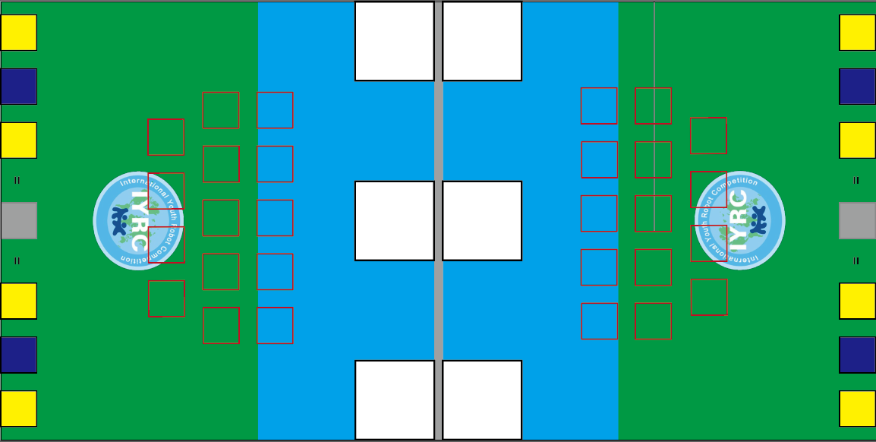
KINDER : MATH CHALLENGE
Age | < 8
Category | Individual
Robot Kits Allowed | MRT Series & HUNA educational robot kit
Mission | Push answer block to the answer box.
Robot Building | Pre-build remote control robot

Slide 12
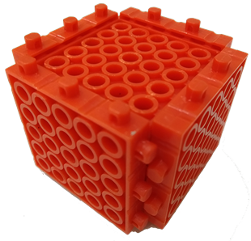
MATH CHALLENGE GAME FIELD
244 cm
10 cm
9
10
10 cm
2
1
Label with numbers 1-10 and place it into
the red squares.
7
8
4
3
X
START/
END
START/
END
-
10 cm
122 cm
5
6
22 cm
6
5
10 cm
-
X
3
4
8
7
22 cm
5 cm
1
2
10
9
5 cm
Answer box
Wall 8 cm high around the field & center barrier

Slide 13
Random Pick Math Card
1+1=
2+1=
2+2=
4+1=
A stack of math cards will be shuffle and let the participant to pick.
4+2=
3+5=
3+4=
4+5=
2+8=
6-5=
9-7=
8-5=
7-3=
6-1=
10-4=
10-3=
10-2=
10-1=

Slide 14
MATH CHALLENGE GAME RULES
Dimensions and Restriction
Initial size shall not exceed 20cm (H) X 20cm (W) X 20cm (L).
Robots are NOT allowed to expand to any size after the game starts.
Maximum 4 DC motors and 1 mainboard.
Game Duration
3 minutes game.
Solve as many math question as possible.
Game Play Details
Robot should stay inside the white square and wait for referee’s instruction.
Once the match has begun, participant should pick a math card randomly form a deck of cards. Then robot must move and push the desire answer block into the grey box.
Once it is done, robot should back to the start/end box and pick another card to solve the math problem. The answer block will also be reset.
Solve as many math problem as possible during the 3 minutes game play.
Scoring
Robot successfully pushes correct answer block into grey box. (10 points each)
Robot back to Start/End box each round. (10 points each)

Slide 15
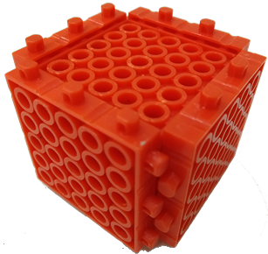
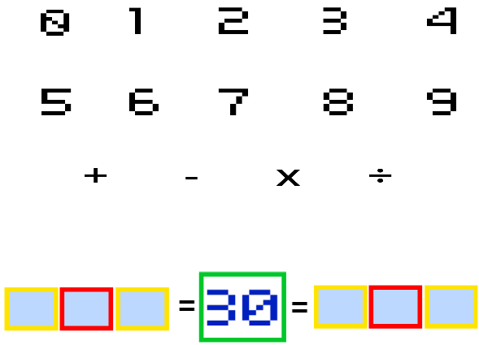
MATH CHALLENGE GAME EXAMPLE
10
1
2
4
2+1=
5
7
Participant pick this math card
6
8
9
-
These blocks (numbers) are to push into
the answer box (grey box)
Answer for the math card
3

Slide 16
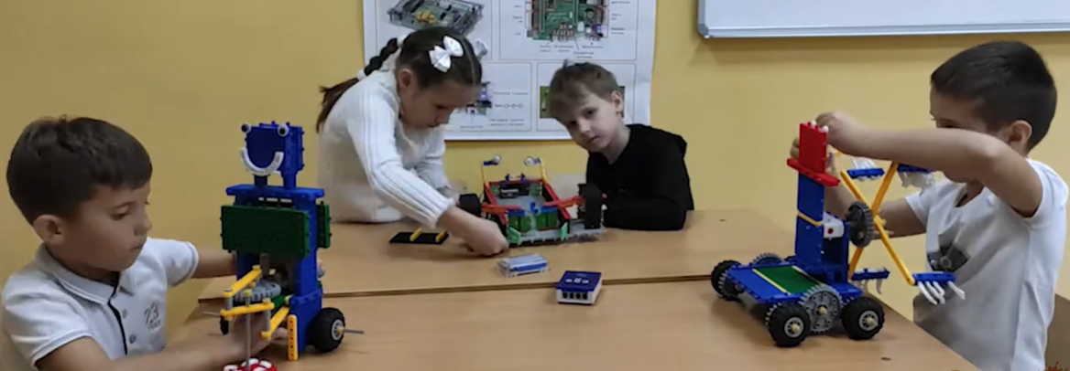
KINDER : YOUNG INNOVATOR
Age | 5-8 years old (Based on year)
Category | Grouping ( max 3 people in a team)
Robot Kits Allowed | MRT series product, included CodeSpark (Can combine)
Mission | Participants design robots/models to perform a storytelling presentation
Robot Building | Pre-build
Game Method | On-site presentation and demonstration
Game Duration | Total 5 minutes including Q&A

Slide 17
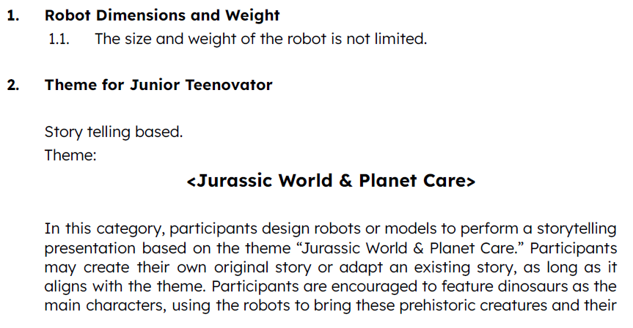
KINDER : YOUNG INNOVATORS

Slide 18
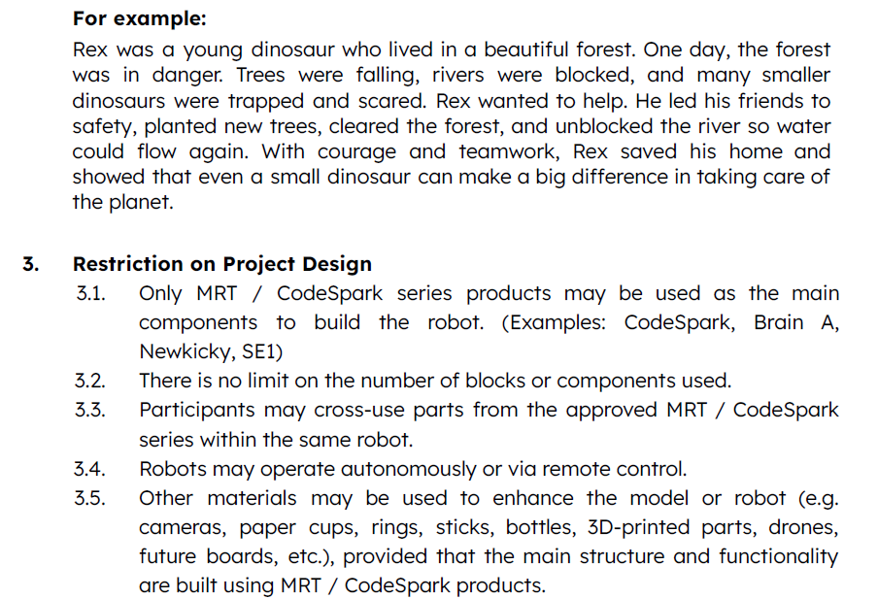
KINDER : YOUNG INNOVATORS

Slide 19
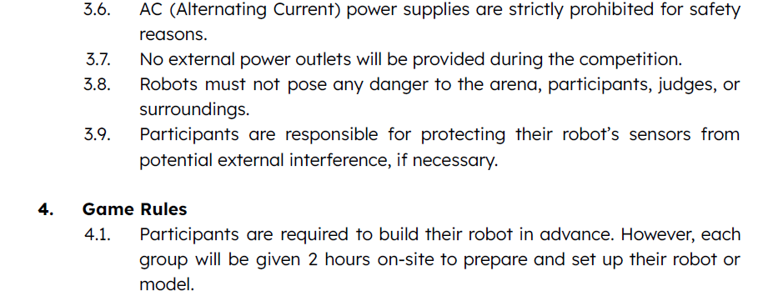
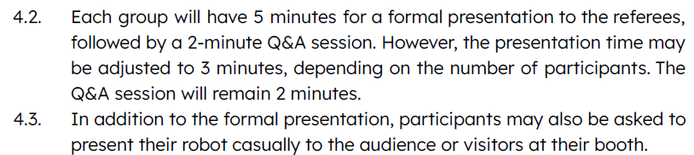
KINDER : YOUNG INNOVATORS

Slide 20
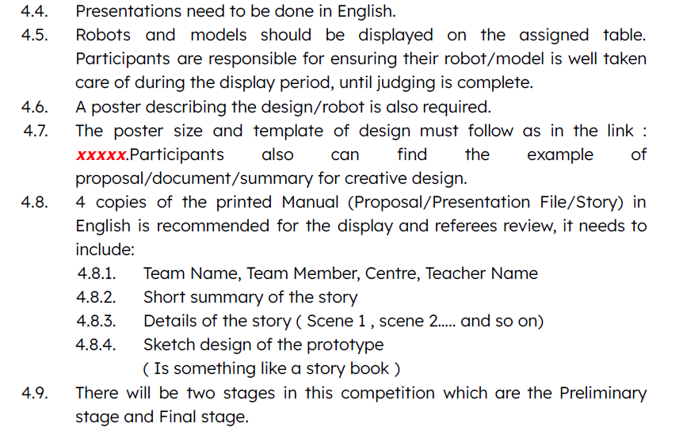
KINDER : YOUNG INNOVATORS

Slide 21
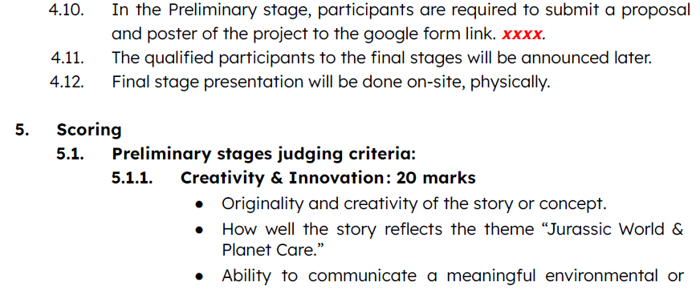
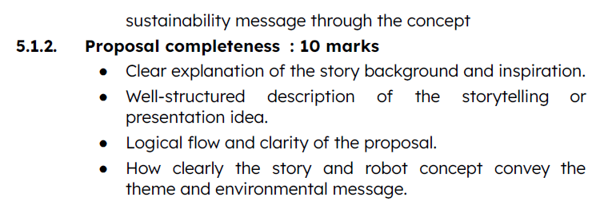
KINDER : YOUNG INNOVATORS

Slide 22
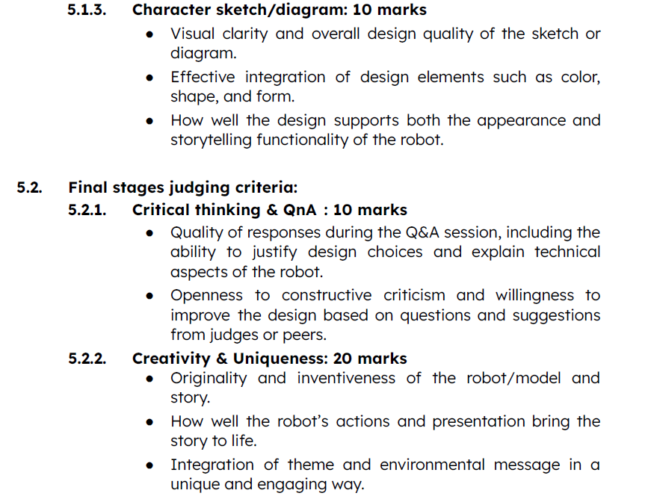
KINDER : YOUNG INNOVATORS

Slide 23
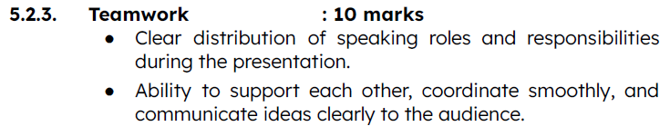
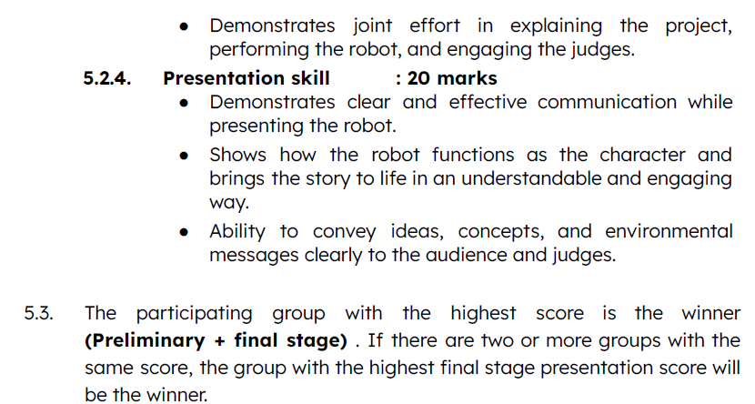
KINDER : YOUNG INNOVATORS

Slide 24
JUNIOR CATEGORY
Animal Kingdom
Math Challenge
Push-Push
Robot Soccer
Communication Master III
Wandering Planet III

Slide 25
JUNIOR : ANIMAL KINGDOM
Age | 8-13
Category | Individual Timed Mission
Robot Kits Allowed | MRT Series & HUNA educational robot kit
Mission | Program robot to trace line and complete the missions
Robot Building | Pre-build & pre-programmed

Slide 26
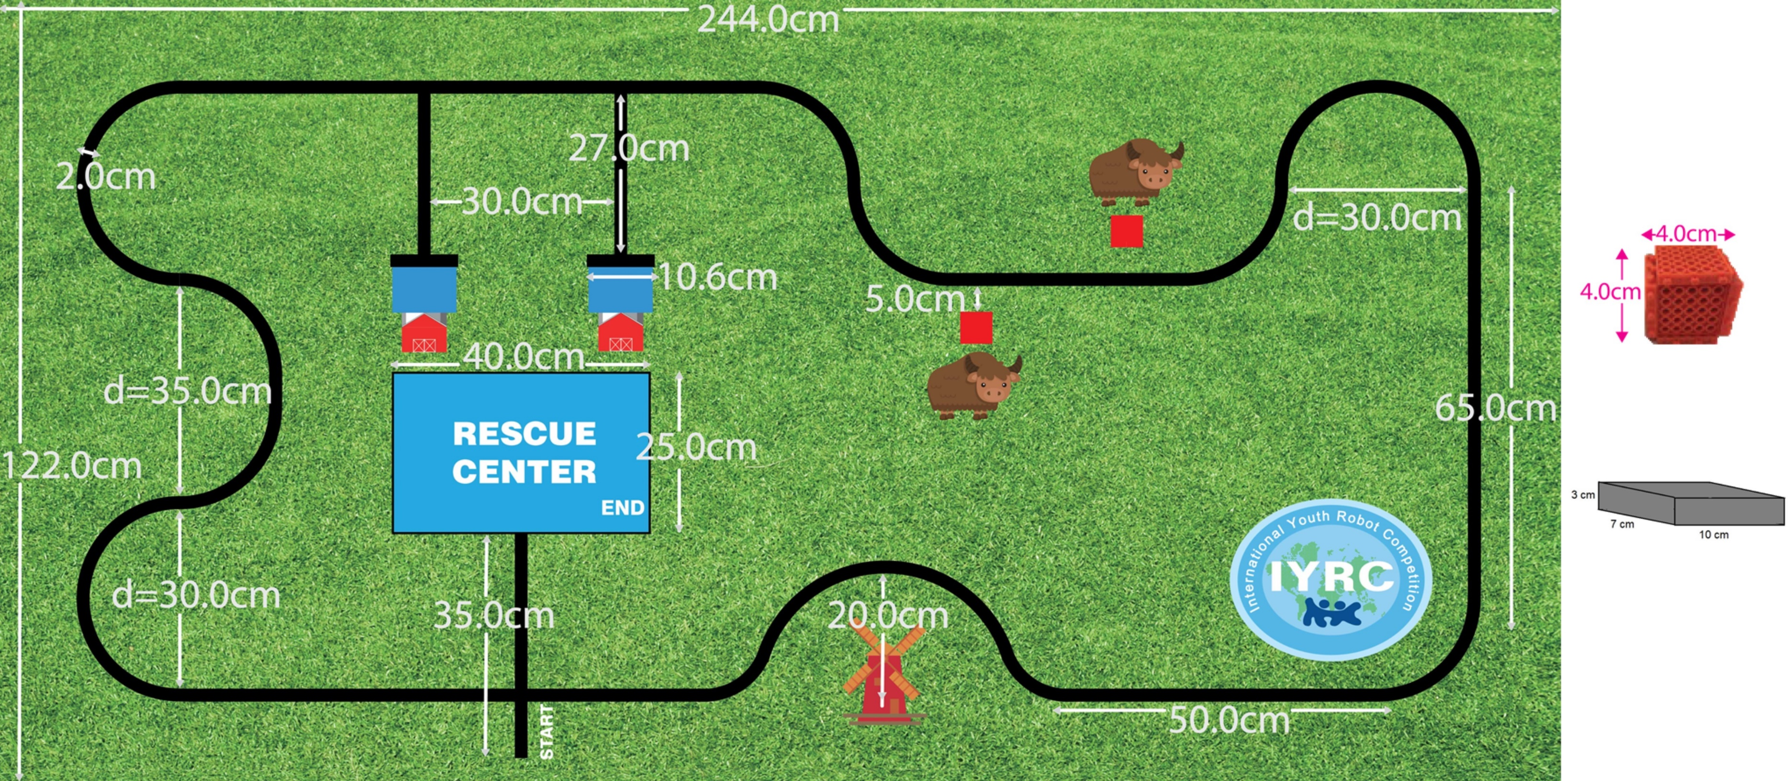
ANIMAL KINGDOM GAME FIELD

Slide 27
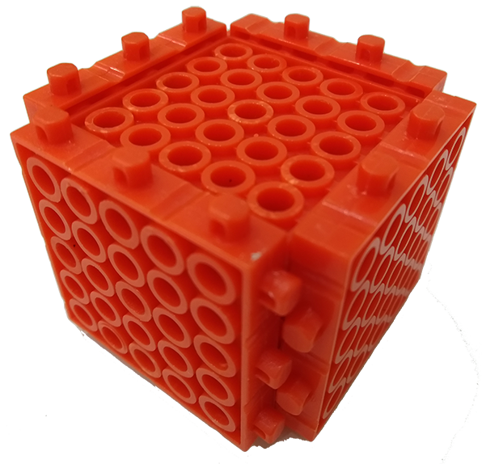
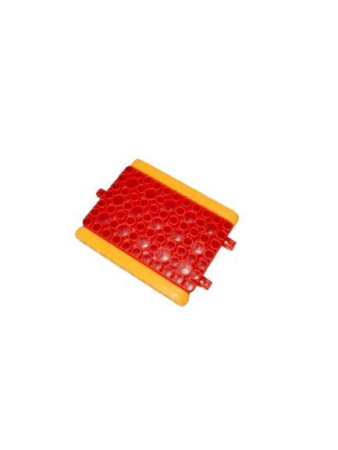
INJURED ANIMAL
& FOOD
For injured animals and food, it is as picture on right it assembled with 6 pcs of 5*5 blocks.
Food will be placed on a stage like picture on the right.

Slide 28
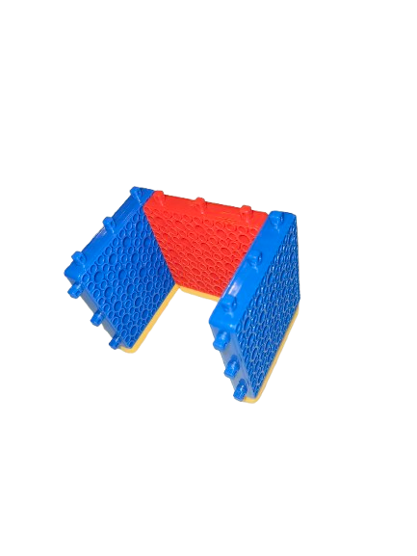
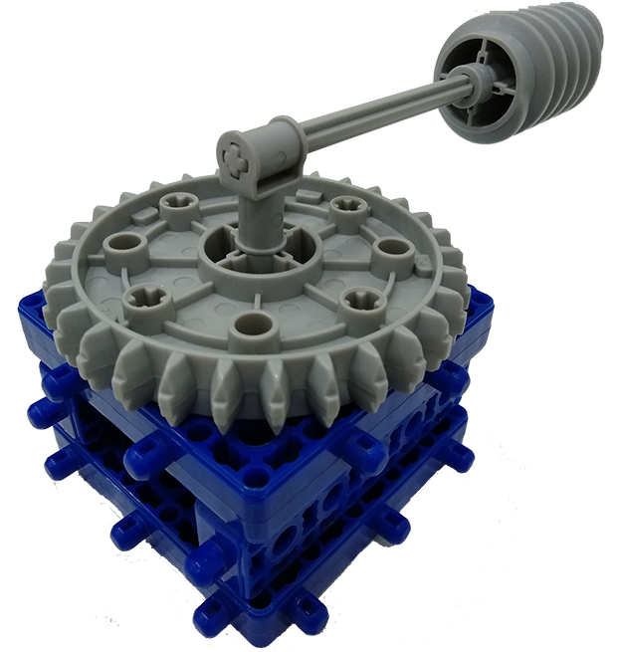
ANIMAL BARN
& FOOD
Horse & Cow barn as picture on
the right.
Power Generator Switch:
L: 20cm, H : 7cm ,
Cube:
L : 7cm, H : 5cm , W:7cm

Slide 29
ANIMAL KINGDOM GAME RULES
Dimensions and Restriction
Initial size shall not exceed 20cm (H) X 20cm (W) X 20cm (L).
Robots are NOT allowed to expand to any size after the game starts.
Maximum 4 DC motors, 5 IR sensors, 2 servo motors, 1 tracer sensor block and 1 mainboard.
Game Duration
Each match is stipulated for 2 rounds with a total duration for a maximum 3 minutes.
Game may end before 3 minutes when :
  Completion of 2 rounds
  Disqualification of a participant
  When referee judges that the continuation of the match is impossible
Scoring
Robot successfully pushes food into barn shed. (15 points each)
Collect injured animals at the road side. (5 points each for removing them from the injured area)
Switch the generator on by spinning the long stick at the semi-circle. (20 points)
Successfully bringing the injured animals back to the Rescue Center. (10 points for each animal)
Robot stops at the Rescue Center. (20 points)

Slide 30
ANIMAL KINGDOM GAME RULES
Game Play Details
Robot should stay behind the starting line (distance from starting line to the Robot IR sensors not exceed 5cm) and facing west (R&R map position as the reference). Timer starts when the robot's IR sensors cross the starting line.
Once the match has begun, the robot must move by its own to complete the following task:
  Task 1 : Push the food into horse and cow barn.
  Task 2 : Carry the two injured animals away from their initial location.
  Task 3 : Switch on the power generator by passing through the semi-circle following the line and pushing the long stick, robot that does not follow the line and move to the next checkpoint would not be awarded points.
  Task 4 : Make sure all injured animals carried by robot is placed into the Rescue Center. No points awarded if any part of the injured animals is out of the Rescue Center’s black box.
  Task 5 : Robot stops at the Rescue Center with any part of the robot’s body stays inside the Rescue Center area.
Win/Lose Criteria
Highest score of the two attempts will be used for ranking of winners.
Participant with the highest score is the winner. If there are two or more participants with the same score, the lowest time recorded to finish the mission is the winner.
If both points and time of participants are the same, the participant who is younger would be the winner.

Slide 31
ANIMAL KINGDOM SCORE EXAMPLE
Child | Task 1 | Task 2 | Task 3 | Task 4 | Task 5 | Total Points | Time Taken | Rank
A (9yo) | 30 | 10 | 20 | 20 | 20 | 100 | 150 | 3
B (7yo) | 30 | 10 | 20 | 20 | 20 | 100 | 150 | 2
C | 30 | 10 | 20 | 20 | 20 | 100 | 130 | 1
D | 30 | 10 | 20 | 20 | 0 | 80 | 120 | 4

Slide 32
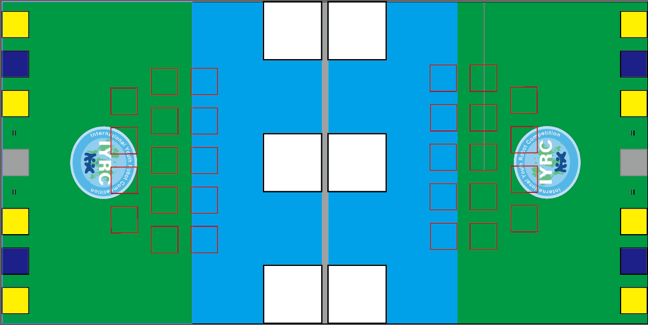
JUNIOR : MATH CHALLENGE
Age | 8-13
Category | Team 2 VS 2 (Tournament)
Robot Kits Allowed | MRT Series & HUNA educational robot kit
Mission | Push blocks to form equation
Robot Building | Pre-build remote control robot

Slide 33
MATH CHALLENGE GAME FIELD
244 cm
START/
END
START/
END
10 cm
10 cm
10 cm
9
4
10 cm
0
5
/
+
Label with numbers 0-9 & operator +,-,x,/.
Place it into the red squares.
8
3
1
6
X
START/
END
START/
END
-
122 cm
7
2
22 cm
2
7
-
X
6
1
3
8
+
22 cm
5 cm
/
5
0
4
9
5 cm
Block 55
START/
END
START/
END
Team A
Team B
Wall 8 cm high around the field & center barrier

Slide 34
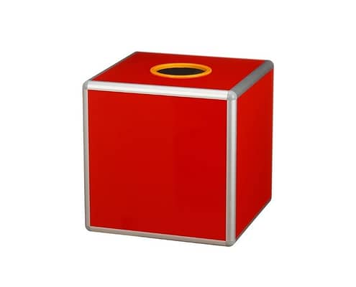
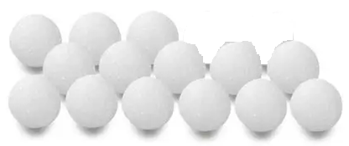
Random Pick Number
}
14 table tennis ball label with numbers put inside a lucky draw box.
14
15
16
7
8
9
10
12
1
2
3
4
5
6

Slide 35
MATH CHALLENGE GAME RULES
Dimensions and Restriction
Initial size shall not exceed 20cm (H) X 20cm (W) X 20cm (L).
Robots are NOT allowed to expand to any size after the game starts.
Maximum 4 DC motors and 1 mainboard.
Game Duration
3 minutes max.
Game Play Details
Robots should stay inside any 2 of the Start/End box and wait for referee’s instruction.
Each participant will pick a number form the lucky draw box, so each team has 2 equation to be solved. One of the number will be place on the block 55 of their field and wait for game start.
Once the match has begun, the robots must move and push the desire number block and operator block into the yellow and blue square to form the correct equation.
After the correct equation is formed, both robots must return to its start box (white square) in order to declare the completion of the first game.
After confirmed by the referee, then, referee will replace the second number on the block 55, the team can start to solve the second equation. If solved, robot should return to any of the Start/End box to declare the completion of the match.

Slide 36
MATH CHALLENGE GAME RULES
Win/Lose Criteria
Team that finish the game earlier will be the winner.

Slide 37

MATH CHALLENGE GAME EXAMPLE
0
2
4
5
7
8
Each of these square box (numbers and operators)
can only use once to form the equation.
-
x
6
+
3
9
/
1
9

Slide 38
JUNIOR : PUSH-PUSH
Age | 8-13
Category | 1 vs 1 Tournament
Robot Kits Allowed | MRT Series & HUNA educational robot kit (Exclude Kicky and Brain kit)
Mission | Remote control robot push opponent outside of the black ring
Robot Building | Pre-build remote control robot
30cm
2.5cm
2cm
20cm
20cm

Slide 39
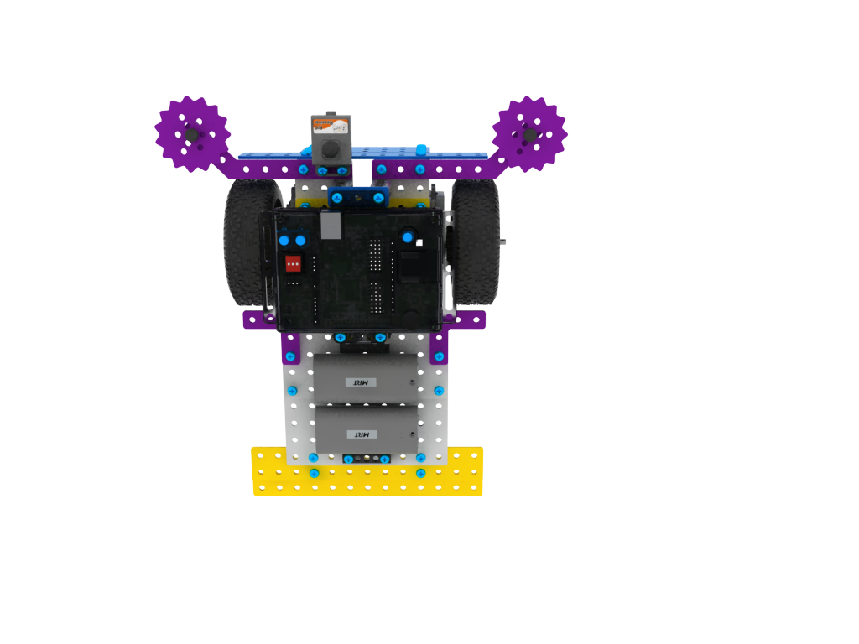
PUSH-PUSH ROBOT PLACEMENT
Robot 1
Robot 2
Robot 1
Robot 2
Robot 1
Robot 2
Imagery
Extension Line
Robots are allow to place in any position on the game field as long as the wheel is in the imagery extension line.

Slide 40
PUSH-PUSH GAME RULES
Dimensions, Weight and Restrictions
The robot must adhere to a maximum size of 20cm (H) x 20cm (W) x 20cm (L) and may not exceed these dimensions at any point after the game has commenced.
The robot's maximum weight, including batteries, must not exceed 1 kg.
The robot is permitted a maximum of 4 DC motors, 2 servo motors and 1 mainboard.
No modifications to the parts are allowed, including bending, sharpening, or altering their shape. All components must remain in their original form.
Game Duration
Each match consists of 3 rounds, with a maximum duration of 1 minute per round.
Scoring
Draw: If both robots are still moving and remain within the play field, each robot will be awarded 1 mark.
Draw: If both robots fall off the play field at the same time, neither robot will receive any marks.
Win: A robot wins if it pushes at least half of the opponent's robot out of the play field or if the opponent's robot is unable to return to the play field. The winner receives 2 marks, while the loser receives 0 marks.

Slide 41
AUTONOMOUS PUSH-PUSH GAME RULES
Game Play Details
First whistle
  Both participants place the robot at the same time on the game field according to the placement criteria, ensuring compliance with the permitted placement guidelines. Not allow to change the robot’s position after the placement done. Turn on the robot and ready for remote control. Participant is require to step away 1 foot from the game field and get ready.
Second whistle
  The participant use remote control to control the robots and attempt to push opponent off the game field.
Win/Lose Criteria
The robot that pushes the opponent's robot off the playfield within 1 minute will be declared the winner of the round. If both robots fall off the playfield simultaneously, the round will result in a draw.
If more than half of the robot's body is pushed outside the playfield (as determined by the referee), or if the robot is unable to return to the ring, it will be considered a loss for the round.
In the event of a draw after 3 rounds, the participant with the lighter robot will be considered the winner.

Slide 42
AUTONOMOUS PUSH-PUSH GAME RULES
Rules Clarification
The referee’s decision is considered as final during game play and objections to the referee’s judgement will not be entertained.
Mentors must not be involved in any rules discussion for the game play.
Video evidence will not be accepted.
Once the Head Referee and the game referees have made a decision, no further discussions will be entertained.

Slide 43
JUNIOR : ROBOT SOCCER
Age | 8-13
Category | Team of 3 (Tournament)
Robot Kits Allowed | MRT Series
Mission | Remote Control robot soccer game
Robot Building | Pre-build soccer robot

Slide 44
ROBOT SOCCER GAME FIELD
Starting position for each team

Slide 45
ROBOT SOCCER GAME RULES
Dimensions and Restrictions
Initial size shall not exceed 25cm (H) X 25cm (W) X 25cm (L).
Robots are NOT allowed to expand to any size after the game starts.
Maximum up to 2 DC motors are allowed.
Robot cannot be designed with a closed structure to handle the ball. The judge will check the robot structure before the competition starts.
Participants have to bring their own laptop computer.
Game Duration
Each game is stipulated for 3 minutes.
Each match is stipulated for 2 rounds with each round’s duration for a maximum of 1.5 minute. After the end of each round the players are to switch to the opposite side of the game field. (Only apply to Semi-final and Final game)
Extension of rounds is only when both sides have the same score. The extension round would be for a maximum of 1 minute. At the event of the same score after the extension round penalty shoot out will commence until a winner is found.
Starting Position
Each team will place their robot’s in front of starting position as indicated in Soccer Game Field diagram before the match/round begins.

Slide 46
AI ROBOT SOCCER GAME RULES
Game Play Details
Team roles :
  1 Defender & 2 Strikers
Defender
  cannot leave own area (own half of the field), therefore cannot enter opponents area.
  allowed to enter own penalty area with non-stop movement to protect the goal, but is Not Allowed more than 10 continuous seconds inside the penalty area or being stationary (not moving) inside penalty area.
Striker
  Allowed to enter both own and opponent’s area
  Allowed to enter opponent’s penalty area to score goal, but not more than 10 continuous seconds inside opponent’s penalty area.
  Not allowed to enter own penalty area.

Slide 47
ROBOT SOCCER GAME RULES
Game Play Details
Fouls:
  Any offender will be issued a yellow card. Upon receiving 2 yellow cards within a match, the player will be removed from play for 1 minute. After 1 minute the offender can re-enter the game field upon referee’s approval. If an offender receives it’s 4th yellow card within a match they are removed from play for the rest of the match.
  When a goal is scored but at the same time or immediately before a foul is made by the same team who scored the goal, the goal would not be valid. (eg: when defender enters opponent’s area when goal is scored)
Type of fouls:
  A robot that purposely block the ball against the side of the field and does not move.
  A Defender that enters the opponent area
  A Striker that enters own penalty area
  A Defender or Striker that stays inside the penalty area for more than 10 continuous seconds
  A Defender that purposely not moving in own penalty area to block the goal post
  A participant who ignores the instruction of the referee
Dead Ball:
  When the ball is held by a robot and not able to move (stalemate) for more than 5 seconds.
  Referee will blow the whistle and all robots must stop. Referee will place the ball accordingly to the situation and the game will resume with referee’s instruction.
  If this happens more than 3 consecutive times, the ball will be placed at the middle and all robots are to return to their starting position.

Slide 48
AI ROBOT SOCCER GAME RULES
Game Play Details
Penalty shoot-out in the event of a draw (only apply to defender robot):
  Ball will be placed on the white dot.
  Robot should start its movement in the mid field circle to hit/push the ball into the goal without any part of the robot’s body crossing the white line.
  3 attempts will be given for each team to score as many goals possible.
  If both teams has the same score after the 3 attempts a Sudden Death will occur.
Sudden Death:
  Each team will send 1 representative for the sudden death round. The representative has 1 chance for a penalty shoot-out. If one team manages to score while the other did not, the scoring team will be the winner. In the event that both teams scores or misses a 1v1 match will begin.
  The first team to score in the 1v1 match will be the winner.
Scoring
Each goal is 1 point awarded to the scoring team.
A goal occurs when the ball is being pushed/hit/rolled into the goal post passing the line.
Win/Lose Criteria
The team with the most goals wins.

Slide 49
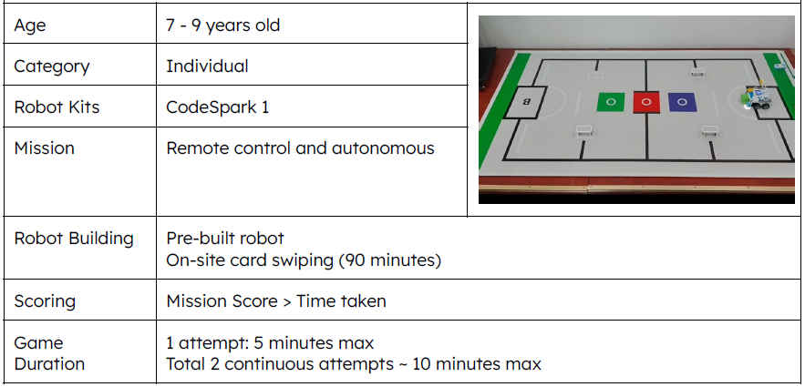
JUNIOR : COMMUNICATION MASTER III

Slide 50
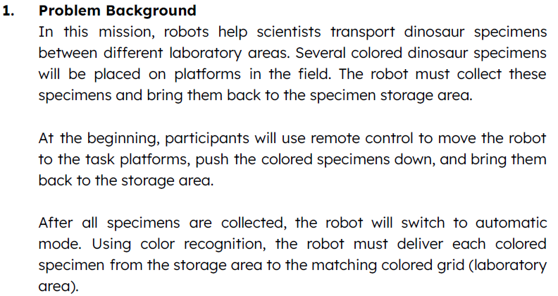
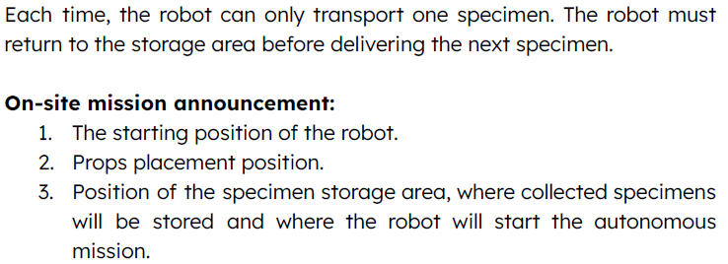
JUNIOR : COMMUNICATION MASTER III

Slide 51
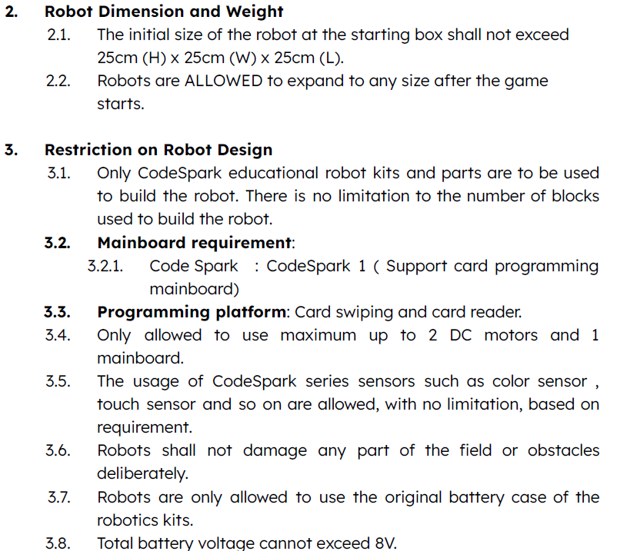
JUNIOR : COMMUNICATION MASTER III

Slide 52
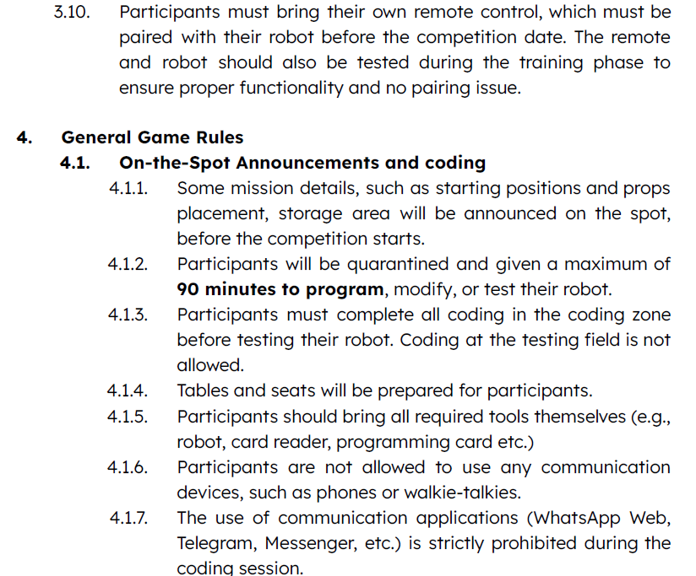
JUNIOR : COMMUNICATION MASTER III

Slide 53
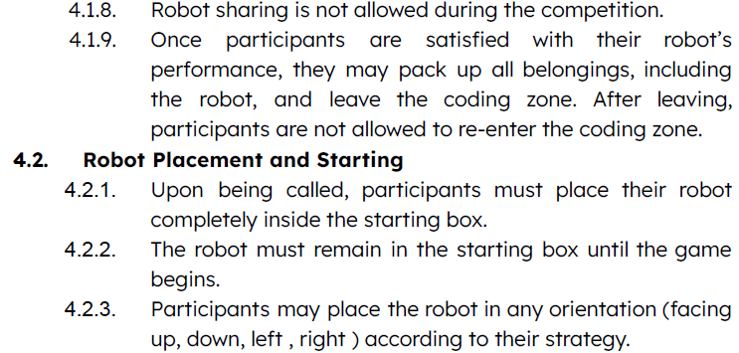
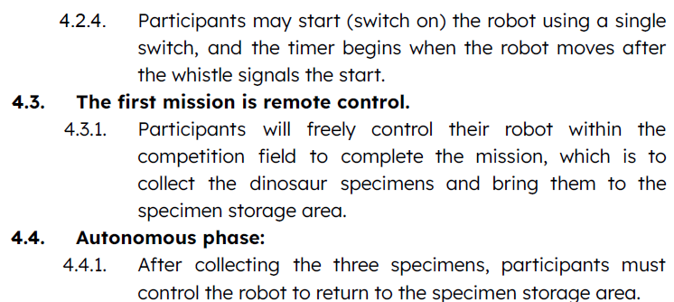
JUNIOR : CMOMMUNICATION MASTER III

Slide 54
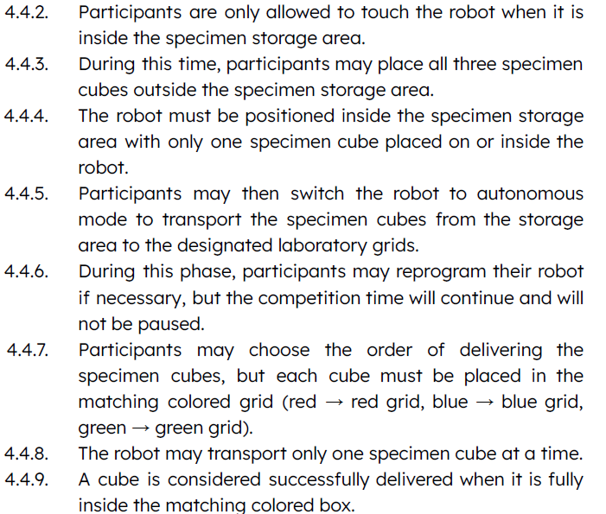
JUNIOR : CMOMMUNICATION MASTER III

Slide 55
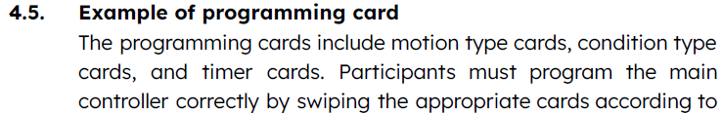
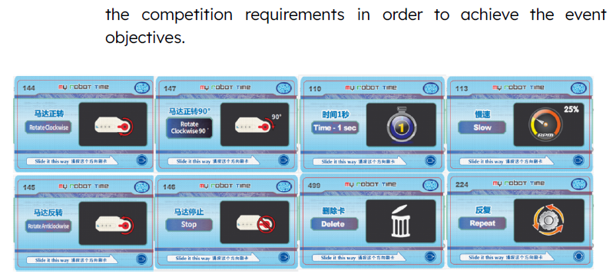
JUNIOR : CMOMMUNICATION MASTER III

Slide 56
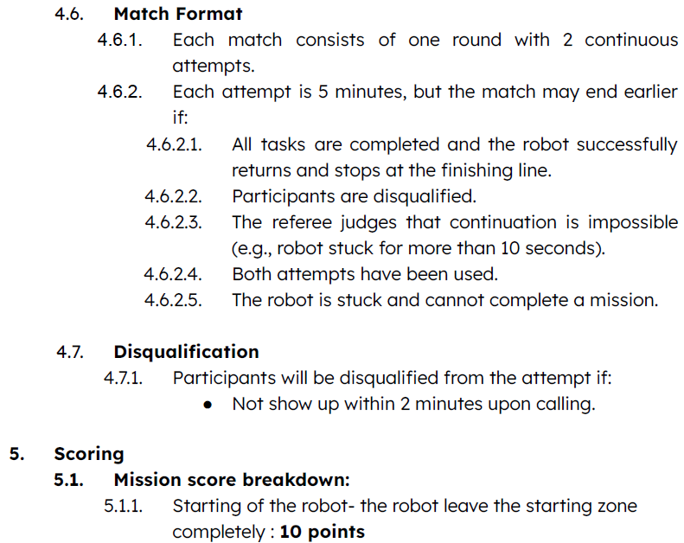
JUNIOR : CMOMMUNICATION MASTER III

Slide 57
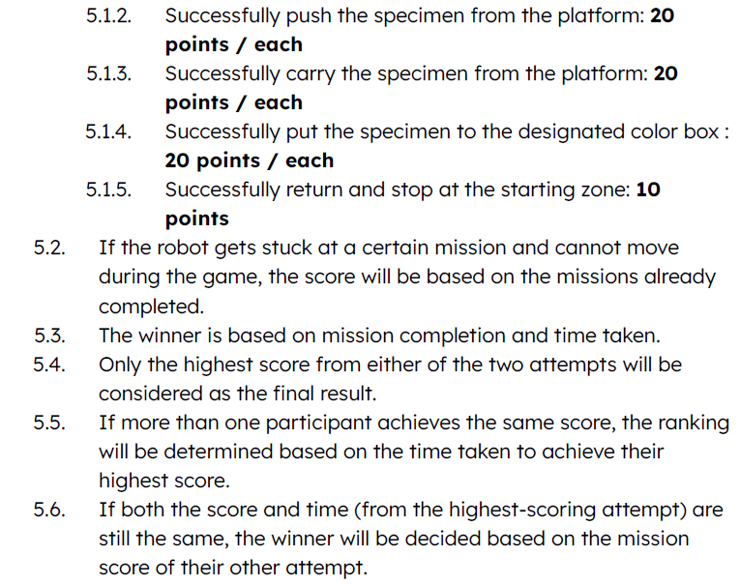
JUNIOR : CMOMMUNICATION MASTER III

Slide 58
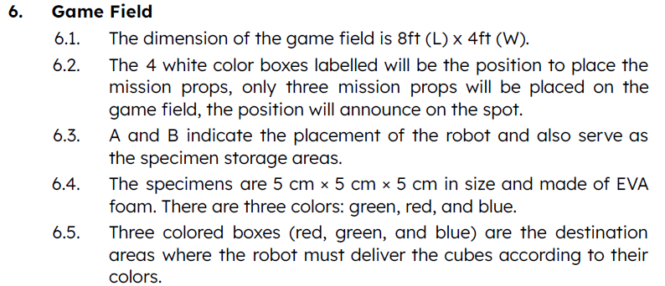
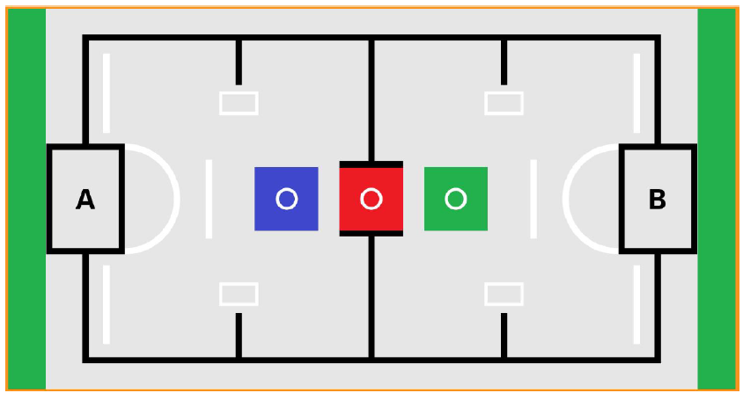
JUNIOR : CMOMMUNICATION MASTER III

Slide 59
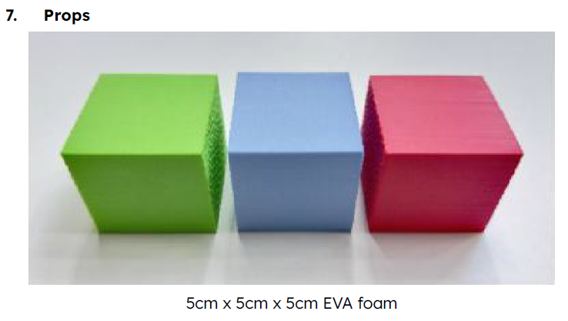
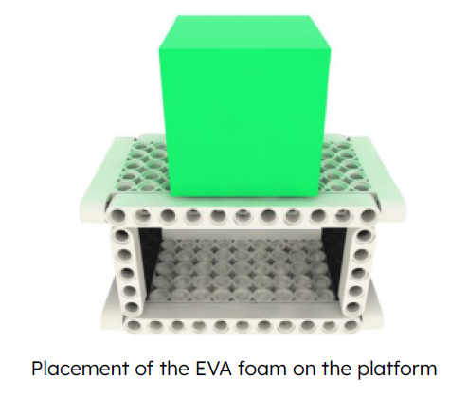
JUNIOR : CMOMMUNICATION MASTER III

Slide 60
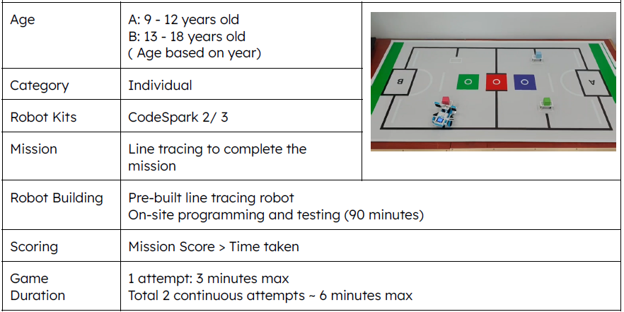
JUNIOR : WANDERING PLANET III

Slide 61
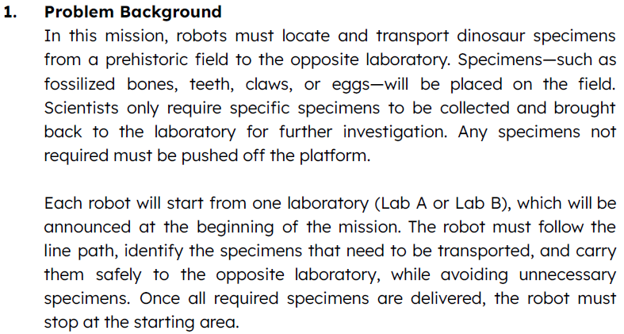

JUNIOR : WANDERING PLANET III

Slide 62
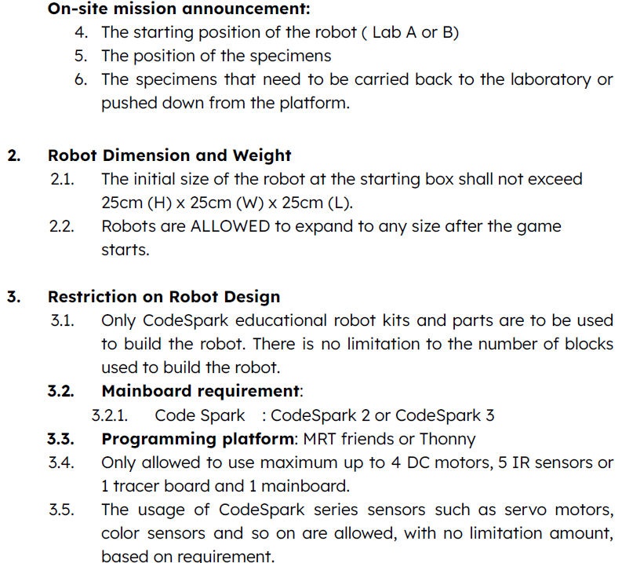
JUNIOR : WANDERING PLANET III

Slide 63
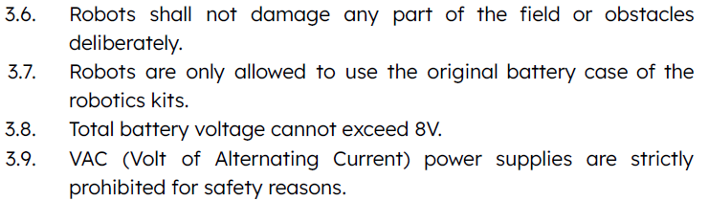
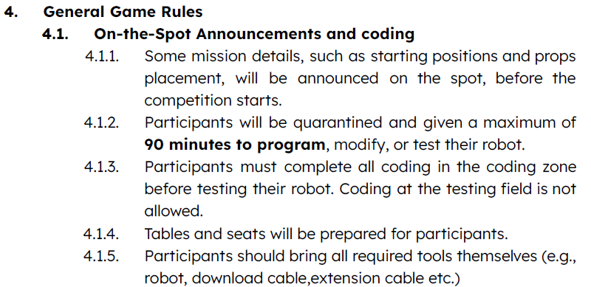
JUNIOR : WANDERING PLANET III

Slide 64
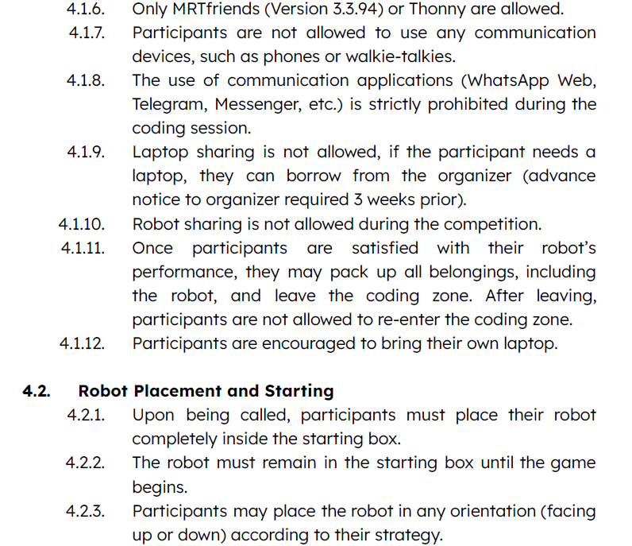
JUNIOR : WANDERING PLANET III

Slide 65
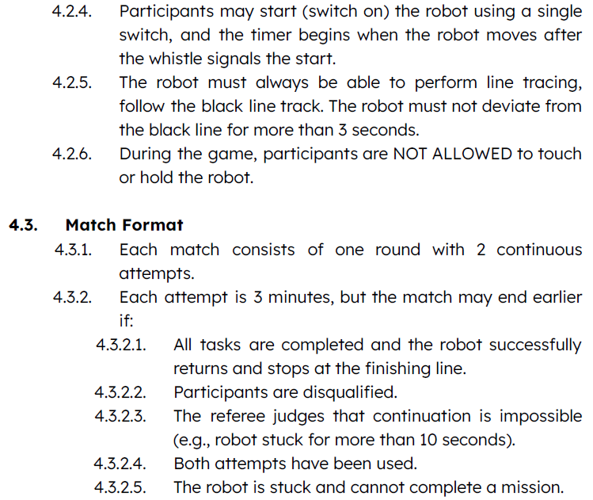
JUNIOR : WANDERING PLANET III

Slide 66
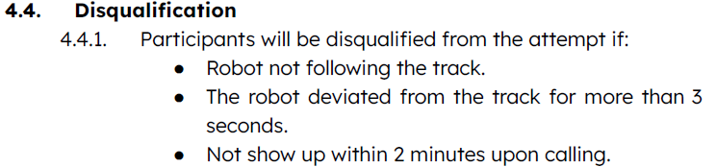
JUNIOR : WANDERING PLANET III

Slide 67
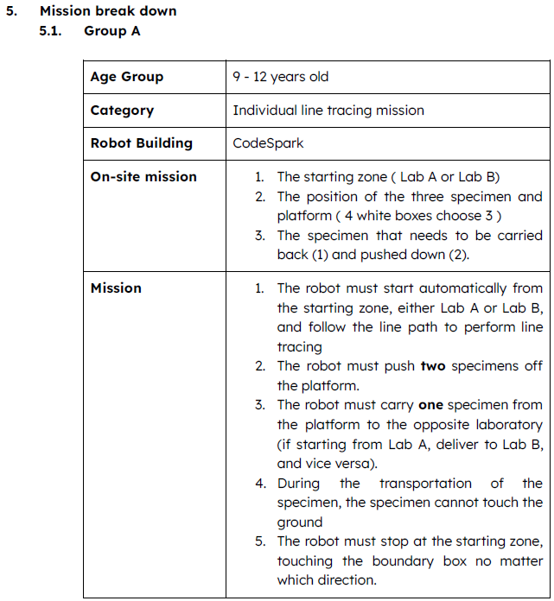
JUNIOR : WANDERING PLANET III

Slide 68

JUNIOR : WANDERING PLANET III

Slide 69

JUNIOR : WANDERING PLANET III

Slide 70

JUNIOR : WANDERING PLANET III

Slide 71

JUNIOR : WANDERING PLANET III

Slide 72

JUNIOR : WANDERING PLANET III

Slide 73
SENIOR CATEGORY
Eco-Restoration
Robot Volleyball
Autonomous Push-Push
Wandering Planet III

Slide 74

SENIOR : ECO-RESTORATION
Age | 13-18
Category | Individual Timed Mission
Robot Kits Allowed | MRT Series
Mission | Robot runs automatically to trace the black and white line to complete missions
Robot Building | Pre-build & on-site programming

Slide 75


ECO-RESTORATION GAME FIELD
Junk Block
Well trigger
Landfill
Underground
Ore

Slide 76
Trash and Ore
SENIOR : ECO-RESTORATION
Assembled by 6 pcs of 5*5 Blocks
Only one trash block to be carried to landfill. The other 2 ore blocks need to be carried back to start/end box.

Slide 77

Well
SENIOR : ECO-RESTORATION
L : 10cm, H : 15cm , W:7cm
Height of IR sensor from ground : 5.5 cm
Place on blue box (well trigger). Initially Green LED off, after triggered, Green LED will be turned on.

Slide 78
SENIOR : ECO-RESTORATION
Dimensions and Restriction
Initial size shall not exceed 20cm (H) X 20cm (W) X 20cm (L).
Robots are Not allowed to expand to any size after the game starts.
Maximum 4 DC motors, 5 IR sensors, 2 servo motors, 1 tracer sensor block and 1 mainboard.
Game Duration
Each participant is given a maximum of 3 hours to perform the coding and testing of the robot
Each match is stipulated for 2 rounds with a total duration for a maximum 3 minutes.
Game may end before 3 minutes when :
  Completion of 2 rounds
  Disqualification of a participant
  When referee judges that the continuation of the match is impossible

Slide 79
SENIOR : ECO-RESTORATION
Quarantine
During the 3 hours given to perform the coding and testing, all participants are quarantine for said period of time.
Participants are allowed to do testing and modify the robot during the 3 hours given.
Once participant is satisfied with the performance of the robot, they may hand over the robot to the referee before the 3 hours is up.
No more programming or modification is allowed once the 3 hours is up or if the participant hands over the robot to the referee earlier.
Participants would then wait for their turn to be called for the match.
Game Play Details
Robot should stay inside the star/end box.
Whistle will be blown as a sign of start of the match & timer starts.
Participant is allowed to start (switch on) the robot using single switch operation.
The robot must follow the left-hand path, moving counter-clockwise once game started.
  Task 1: Push the "Junk Block" to the landfill.
  Task 2: Enter the underground to repair the well.
  Task 3: Bring the ore back to the starting point.

Slide 80
SENIOR : ECO-RESTORATION
Scoring
Task 1 and task 2 – Each 20 points
Carry the ore back to star/end box – each 10 points
Robot stop inside the start ned box – 20 points
Disqualify
Participant touch the robot or items on the game field during the game play.
Stalemate of more than 5 sec.
Not tracing the line for more than 5 sec.
Win/Lose Criteria
Highest score of the two attempts will be used for ranking of winners.
Participant with the highest score is the winner. If there are two or more participants with the same score, the lowest time recorded to finish the mission is the winner.
If the points and time of both participants are the same, the participant who is younger would be the winner.

Slide 81
SENIOR : ECO-RESTORATION SCORE EXAMPLE
Child | Task 1 | Task 2 | Task 3 | Stop at Start/End line | Total Points | Time Taken | Rank
A (15yo) | 20 | 20 | 20 | 20 | 80 | 160 | 2
B (13yo) | 20 | 20 | 20 | 20 | 80 | 160 | 1
C | 0 | 20 | 20 | 20 | 60 | 170 | 3
D | 0 | 10 | 20 | 20 | 50 | 140 | 4

Slide 82

SENIOR : ROBOT VOLLEYBALL
Age | 13-18
Category | 2 vs 2 Tournament
Robot Kits Allowed | MRT Series & HUNA educational robot kit
Mission | Remote control robot to transfer table tennis balls into opponent’s field
Robot Building | Pre-build remote control robot

Slide 83

ROBOT VOLLEYBALL GAME FIELD

Slide 84

ROBOT VOLLEYBALL GAME FIELD

Slide 85
ROBOT VOLLEYBALL GAME RULES
Dimensions and Restrictions
Initial size shall not exceed 25cm (H) X 25cm (W) X 25cm (L). However, robots are allowed to expand to any size after the game starts
Maximum up to 2 DC motors, 2 servo motors and 1 mainboard are allowed
Game Duration
Each match is stipulated for 1 round with a duration for a maximum of 3 minutes.
Extension of rounds is only when both sides have the same score. Each round extension would be for a maximum of 30 seconds and 1 robot from each team will be chosen to compete in the current state of the game field to determine the final winning team.
Game may end before 3 minutes when :
  One team manages to throw all balls into opponent field
  Disqualification of both participants from the same team

Slide 86
ROBOT VOLLEYBALL GAME RULES
Game Play Details
Each team will have 20 table tennis balls placed on top of two different height towers in their own field.
Each team can deploy any tactics or manoeuvres to grab or collect the table tennis balls from the tower and transfer them into the opponents’ field.
If the table tennis ball is thrown outside the field, the ball will be put back to the side where the ball was thrown out from by the referee.
Win/Lose Criteria
Draw : Both sides have equal number of balls thrown to the other side.
Win : Team which has the most number of tennis balls thrown to the opponent’s side or have successfully thrown all tennis balls over to the opponent’s side before the time ends.
Lose : Team which has the least number of tennis balls thrown to the opponent’s side or have all team members removed from play due to foul or disqualification.

Slide 87
SENIOR : AUTONOMOUS PUSH PUSH
Age | 13-18
Category | 1 vs 1 Tournament
Robot Kits Allowed | MRT Series educational robot kit (Exclude Kicky and Brain kit)
Mission | Autonomous robot to push opponent out of the ring
Robot Building | Pre-build autonomous robot
30cm
2.5cm
2cm
20cm
20cm

Slide 88
AUTONOMOUS PUSH-PUSH ROBOT PLACEMENT
Robot 1
Robot 2
Robot 1
Robot 2
Robot 1
Robot 2
Imagery
Extension Line
Robots are allow to place in any position on the game field as long as the wheel is in the imagery extension line.

Slide 89
AUTONOMOUS PUSH-PUSH GAME RULES
Dimensions, Weight and Restrictions
The robot must adhere to a maximum size of 20cm (H) x 20cm (W) x 20cm (L) and may not exceed these dimensions at any point after the game has commenced.
The robot's maximum weight, including batteries, must not exceed 1 kg.
The robot is permitted a maximum of 4 DC motors, 3 touch sensors, 3 IR sensors, 2 servo motors, 1 ultrasonic sensor, and 1 mainboard.
The robot can be programmed with a maximum of three strategies, each activated separately by the touch sensors. During each round, only one strategy can be activated, initiated by pressing one of the touch sensors.
No modifications to the parts are allowed, including bending, sharpening, or altering their shape. All components must remain in their original form.
Game Duration
Each match consists of 3 rounds, with a maximum duration of 1 minute per round.
Scoring
Draw: If both robots are still moving and remain within the play field, each robot will be awarded 1 mark.
Draw: If both robots fall off the play field at the same time, neither robot will receive any marks.
Win: A robot wins if it pushes at least half of the opponent's robot out of the play field or if the opponent's robot is unable to return to the play field. The winner receives 2 marks, while the loser receives 0 marks.

Slide 90
AUTONOMOUS PUSH-PUSH GAME RULES
Game Play Details
First whistle
  Both participants place the robot at the same time on the game field according to the placement criteria specified for the selected strategy, ensuring compliance with the permitted placement guidelines. Not allow to change the robot’s position after the placement done.
Second whistle
  Press the touch sensor / turn on the robot to activate the selected strategy. Once activated, participants must step back and maintain a distance of at least one foot from the game field. The robot will then begin engaging the opponent autonomously, attempting to push opponent off the game field.
Win/Lose Criteria
The robot that pushes the opponent's robot off the playfield within 1 minute will be declared the winner of the round. If both robots fall off the playfield simultaneously, the round will result in a draw.
If more than half of the robot's body is pushed outside the playfield (as determined by the referee), or if the robot is unable to return to the ring, it will be considered a loss for the round.
In the event of a draw after 3 rounds, the participant with the lighter robot will be considered the winner.

Slide 91
AUTONOMOUS PUSH-PUSH GAME RULES
Rules Clarification
The referee’s decision is considered as final during game play and objections to the referee’s judgement will not be entertained.
Mentors must not be involved in any rules discussion for the game play.
Video evidence will not be accepted.
Once the Head Referee and the game referees have made a decision, no further discussions will be entertained.

Slide 92
SENIOR : WANDERING PLANET III

Slide 93
JUNIOR : WANDERING PLANET III

Slide 94
JUNIOR : WANDERING PLANET III

Slide 95
JUNIOR : WANDERING PLANET III

Slide 96
JUNIOR : WANDERING PLANET III

Slide 97
JUNIOR : WANDERING PLANET III

Slide 98
JUNIOR : WANDERING PLANET III

Slide 99

JUNIOR : WANDERING PLANET III

Slide 100

JUNIOR : WANDERING PLANET III

Slide 101

JUNIOR : WANDERING PLANET III

Slide 102

JUNIOR : WANDERING PLANET III

Slide 103
JUNIOR : WANDERING PLANET III

Slide 104
JUNIOR : WANDERING PLANET III

Slide 105
COMPULSORY
Creative Robot Design (Junior + Senior)
“Jurassic Intelligence X AI Innovation”

Slide 106

CREATIVE ROBOT DESIGN (Compulsory)
Age | Junior & Senior
Category | Grouping (3 people max in a team)
Robot Kits Allowed | MRT series product, included CodeSpark (Can combine)
Mission | Combination of robotic and technical presentation based on Theme given
Robot Building | Pre-build
Game Method | On-site presentation and demonstration
Game Duration | 5 minutes (include 2 minutes Q&A)

Slide 107
CREATIVE ROBOT DESIGN
Robot Dimension and Weight
1.1 The size and weight of the robot is not limited.
2. Theme (Choose one of the below category)
Category 1 : Jurassic Intelligence.
Step into a world millions of years in the past—an untamed land where survival depends on instinct,
adaptation, and intelligence. In Jurassic Intelligence, participants are challenged to reimagine prehistoric
life through modern robotics by creating machines that behave like dinosaurs in a dynamic ecosystem.
This theme encourages you to combine creativity, storytelling, and intelligent system design,
transforming robotics into an immersive experience where technology brings an ancient world back to life.
Category 2 : SDG Goals (https://sdgs.un.org/goals)
SDG 13 – Climate Action , SDG 14 – Life Below Water (ocean), SDG 15 – Life on Land (forest, wildlife) or
SDG 2 – Zero Hunger
Build a robotic system to address the real-world problem based on the theme and present how the system
helps solve or prevent challenges related to the theme. Demonstrate key aspects such as effectiveness,
reliability, adaptability and ease of use.

Slide 108

CREATIVE ROBOT DESIGN

Slide 109


CREATIVE ROBOT DESIGN

Slide 110

CREATIVE ROBOT DESIGN

Slide 111

CREATIVE ROBOT DESIGN

Slide 112

CREATIVE ROBOT DESIGN

Slide 113

CREATIVE ROBOT DESIGN

Slide 114

CREATIVE ROBOT DESIGN

Slide 115
OPEN CATEGORY
Humanoid Robot Mission
Genibot Coding Mission
Game Maker Kit Game Design Challenge
Drone Soccer
Drone Mission
Cocomon GO

Slide 116

OPEN : HUMANOID ROBOT MISSION
Age | All
Category | Individual Timed Mission
Robot Kits Allowed | MRT LINE Core Humanoid
Mission | Control the humanoid to complete missions
Robot Building | Pre-programmed LINE Core Humanoid

Slide 117

HUMANOID ROBOT MISSION GAME FIELD

Slide 118

MISSION 1
Robot needs to crawl under obstacles placed on the passage. Successfully completed mission will be awarded 20 points.

Slide 119

MISSION 2
Robot needs to use hand to carry the props (6cm soft sponge cube) and robot legs must cross the red line before dropping the props to designated area. Successfully completed mission will be awarded 20 points.

Slide 120

MISSION 3
Robot needs to use a foot to kick the soccer ball(there are 2 balls ) into the slot label with 16/18/20/18/16. The ball successfully enters into the highest point slot will be recorded.

Slide 121

MISSION 4
Robot need to cross above the obstacle placed in the passage. Must be in standing position. Successfully completed mission will be awarded 20 points.

Slide 122

MISSION 5
Robot can only walk through the two steps staircase (walk up stairs 5 points, walk down stairs 5 points) and then walk through the Z- type route to reach the end (10 points).

Slide 123
HUMANOID ROBOT MISSION GAME RULES
Dimensions and Restrictions
Only MRT LINE Core Humanoid and its parts are allowed to use.
The battery specification, length of robot leg and arm should strictly adhere to the instruction manual (LINE Core Humanoid).
Game Duration
Each match is stipulated for 1 round with a duration for a maximum of 5 minutes.
Game may end before 5 minutes when :
  Robot reached the end line.
  Disqualification of a participant
  When referee judges that the continuation of the match is impossible

Slide 124
HUMANOID ROBOT MISSION GAME RULES
Game Play Details
Participant should prepare their own Android device (Airplane Mode) to control the robot.
Robot can start to move once the whistle blown.
During the game, if robot out of battery and not be able to control anymore, game will be terminated and current point will be recorded.
Each mission has 2 tries. The second try, referee will place the robot at the starting point of the mission / the point gap of the mission.
If both failed, then referee will move it to the next mission starting point / next point gap.
Win/Lose Criteria
Participant with the highest score is the winner. If there are two or more participants with the same score, the lowest time recorded to finish the missions is the winner.
If the points and time of both participants are the same, the participant who is younger would be the winner.

Slide 125

OPEN : GENIBOT CODING MISSION
Age | ALL
Category | Team of 2
Robot Kits Allowed | GENIBOT
Mission | Unplugged Coding – Waste Separation Mission
Robot Building | Pre-build robot
Age | 8-13
Category | 2 vs 2
Robot Kits allowed
Mission
Robot Building

Slide 126
GENIBOT CODING MISSION
WASTE SEPARATION MISSION GAME FIELD
Mission items :
A - Glass
B - Metal
C - Plastic
D - Paper

Slide 127

GENIBOT CODING MISSION
Waste Separation Mission Card Example
Glass
Initial spot of mission items
X - Obstacle
Destination of each mission items

Slide 128
GENIBOT CODING MISSION GAME RULES
Dimensions and Restrictions
Initial size shall not exceed 25cm (H) X 25cm (W) X 25cm (L).
Robots are NOT allowed to expand to any size after the game starts.
Maximum up to 2 DC motors are allowed.
Game Duration
Each game is stipulated for 3 minutes.
Once the mission card is drawn, teams have only 5 minutes to program the Genibot.
Starting Position
Each team places their Genibot at two of the four available starting corners depend on their program strategy.

Slide 129
GENIBIT CODING MISSION GAME RULES
Game Play Details
The playing field is a grid pattern. Genibot can only move in grid units.
There are 4 types of mission items to be collected in the playing field and send to the destination base on the mission card.
The two Genibots start from any 2 corner of the starting position.
Participants have to program the Genibot according to the drawn mission card, such as forward, backward, and rotate, to move objects to the destination while avoiding the obstacles.
Participants have to pass the mission card to the referee before the game start to prepare the game items accordingly.
When moving objects on the playing field, the two Genibots proceed separately at the same time, and the mission is completed when both Genibot moves the mission items to the correct destination.
Game may end before 3 minutes when :
- Both Genibots have completed the missions.
- Referee judges that the continuation of the match is impossible

Slide 130
GENIBOT CODING MISSION GAME RULES
Scoring
Time recorded for mission completion.
Win/Lose Criteria
The team with shortest time is the winner.

Slide 131
GENIBOT CODING MISSION SCORE EXAMPLE
Child | Mission Completed | Time Recorded (sec) | Rank
A (9yo) | 3 | ~ | 3
B | 4 | 130 | 2
C | 4 | 120 | 1
D (10yo) | 3 | ~ | 4

Slide 132

OPEN : GAME MAKER KIT GAME DESIGN CHALLENGE
Age | 8-13
Category | 2 vs 2
Robot Kits allowed
Mission
Robot Building
Age | All
Category | Team 1-3 students
Robot Kits Allowed | Game Maker Kit
Mission | Design a proper game based on the theme given and submit online.
Robot Building | Pre-build robot

Slide 133
GAME DESIGN CHALLENGE
Objective
Provide a platform for students to showcase their creativity, innovative and programming skills. They are required to work together as a team to design a game based on the given theme. Besides, they will also need to present and demonstrate their game creation well to convince and impress the referees.
Restrictions on Game design
Only MRT Game Maker Kit is to be used to make game.
Participants should make code at https://arcade.makecode.com.
Participants should make sure that games work properly both at emulator of websites above and MRT Game Maker Kit.

Slide 134
GAME DESIGN CHALLENGE
Game Rules
Participants shall make game code in advance.
Each group has a presentation time of 3 minutes to introduce their games to the referee on the competition place. Presentations can be done in English. If they are unable to present in English, they have to prepare their own translator.
Game kit and laptop may be displayed in the allocated table assigned to each group. Hence, Participants are required to ensure their game kit are taken care of during the display time to the public until the judging is completed.
After registration, a poster(presentation) form will be sent the teams by organizer, and participants need to fill the poster content. Besides, 4 copies of the printed Manual (Presentation File) in English are required for the display and referees review, it needs to include:
Game Name
Purpose
Team member introduction and task allocation
Introduction of the project
How to program (coding block captured)
How to play.
Theme: My Robot, Time to Save the Earth

Slide 135
GAME DESIGN CHALLENGE
Scoring
Referees will check if the team meets the requirements or not, and evaluate teams’ works. Score will be given based on different criteria and weightage respectively:
Relevance to theme: 10 score
Creativity & Uniqueness: 30 score
Code Functionality: 30 score
Team work: 10 score
Presentation skill: 20 score
Additional Points
When participants create their own Character/Background, they will get additional points up to 5 ~10 points.
When participants use more than 3 kinds of coding blocks, they will get additional points up to 5 ~10 points.
e.g.) Loops, Logic, Music···
Participating group with the highest score is the winner. If there are two or more groups with the same score, the lowest average younger participating group is the winner.

Slide 136

OPEN : DRONE SOCCER
Age | 8-13
Category | 2 vs 2
Robot Kits allowed
Mission
Robot Building
Age | Junior Category : 9 to 12 years old Senior Category: 13 to 18 years old
Category | 3 Vs 3
Robot Kits Allowed | Remote Control Drone Soccer Robot
Mission | Control the drone to score in the opponent's goal post or defend your own.
Robot Building | Pre-build robot

Slide 137
OPEN : DRONE SOCCER
1. Overview
Each team consists of one Striker and two Defenders. The Striker’s job is to maneuver the drone through the opponent’s ring to score. The Defenders work together to block incoming attacks and protect their own ring from being pass-through!
Every successful pass-through generates a score. The team with the highest score will win the game.
2. Game Introduction
2.1. Each team consists of three players and three drones. Two teams compete against each other, starting from their home positions at opposite ends of the field.
2.2. Players must remain outside the game field, with each team positioned at their respective end.
2.3. Each team has one striker and two defenders.
2.4. Defenders must stay within their own area to protect their goal post and block the opponent’s striker from scoring. They are not allowed to cross the middle line.
2.5. The striker can cross the middle line into the opponent’s area and use any strategy to score a goal.

Slide 138
3. Robot Dimension and Weight
OPEN : DRONE SOCCER
Age | 8-13
Category | 2 vs 2
Robot Kits allowed
Mission
Robot Building
Type | Ball type remote control drone
Size | Range of 20 to 21 cm include the outer ball type frame. e.g. 21cm(H) x 21cm(W) x 21cm(L).
Weight | The total weight, including the frame and battery, must be less than 200g
Battery Voltage | The voltage must be 7.4V or lower
Battery Capacity | The battery capacity must be 1000mAh or lower

Slide 139
OPEN : DRONE SOCCER
4. Game Rules 4.1. General Rules
4.1.1. All players must remain in the Pilot Area (outside the game field); only drones are allowed inside.
4.1.2. Players cannot exceed the Pilot Area.
4.1.3. The main referee stands in the middle (outside the field) and uses a whistle to signal the start, fouls, and end of the game.
4.1.4. Two assistant referees stand outside the field near the goalposts (one per team) and use flags to indicate whether a goal is approved or disapproved.
4.1.5. Defenders must not cross the half-field line; doing so will result in a foul.
4.1.6. Striker can cross the half-field line to score the opponent’s goal.
4.1.7. After a successful goal, the referee will stop the game with one short whistle, and the timer will pause.
4.1.8. All drones must immediately land at their current position for mark verification.
4.1.9. If a drone flips over or bounces away during landing, the referee will reposition it.
4.1.10. The game resumes with one short whistle. The scoring striker must return to the team base before restarting.
4.1.11. In the last 30 seconds, the main referee will blow two short whistles as a warning.
4.1.12. The game ends after 2 minutes with a whistle signal: one short blow followed by one long blow.
4.1.13. Teams must immediately stop their drones once the game ends.
4.1.14. After scores are confirmed, teams may enter the field to retrieve their drones.
4.1.15. Participant teams will be disqualified if more than 5 warnings are accumulated.

Slide 140
OPEN : DRONE SOCCER
4.1.16. For every foul, 1 warning (yellow card) will be given.
4.1.16.1. Failure to follow referee instructions.
4.1.16.2. Disrespectful behavior towards the referee.
4.1.16.3. Taking off before the starting whistle.
4.1.16.4. Failing to land the drone when the stopping whistle is blown during gameplay.
4.1.16.5. A striker not returning to the team base before attacking again after scoring a goal.
4.1.16.6. A defender crossing the middle line.
4.1.16.7. A defender hovering in the middle of the goal post.
4.1.16.8. A player exceeding their designated Pilot Area.
4.1.16.9. Flying the drone outside the game field.
Any foul committed by a player, regardless of role, will be counted as a team foul.
Master referee have the right to disqualify the team if more than 5 fouls are being made.

Slide 141
OPEN : DRONE SOCCER
4.2. Line Up
4.2.1. Teams must prepare their drones and insert batteries only within the field.
4.2.2. Battery insertion and drone arming outside the field are strictly prohibited.
4.2.3. Drones must be lined up in a straight line in front of the goal post, with:
4.2.4. Striker in the middle
4.2.5. Defenders on the left and right sides
4.2.6. Positions will be clearly labeled on the floor for guidance.
4.2.7. All drones within a team must have matching LED colors:
● RED Team: Striker – Green (with extra label on drone), Defenders – Red
● BLUE Team: Striker – White (with extra label on drone), Defenders – Blue
4.2.8. The LED colors of the striker and defenders may be adjusted based on the available LED colors of the team’s drones.
4.2.9. Participants cannot change LED colors during gameplay unless permitted under Section 13.
4.2.10. Teams have 2 minutes to complete their setup.
4.2.11. Each team must know how to change the LED color on their drones.
4.2.12. Blue and Red teams will be determined by a rock-paper-scissors match between team representatives.

Slide 142
OPEN : DRONE SOCCER
4.3. Pre Start
4.3.1. The main referee will coordinate with the team referees to ensure all safety requirements are met and both teams are ready.
4.3.2. The main referee will announce "Ready," signaling teams to arm their drones in preparation for flight. Takeoff is not allowed at this stage.
4.3.3. To officially start the game, the main referee will blow a long whistle (one time).
4.3.4. Upon hearing the whistle, teams may take off and begin gameplay.
4.4. Striker
4.4.1. The striker can cross the half-line to score in the opponent’s goal.
4.4.2. A goal is counted as valid only if the striker’s drone ball fully crosses the goal line from front to back into the opponent’s goal. (Refer to Diagram 10.1)
4.4.3. After a goal, the main referee will stop the match for mark verification, and all drones must immediately land.
4.4.4. When the game resumes, the scoring striker must return back to the original team base before attacking again.
4.4.5. If a striker scores in their own goal post, it is considered an invalid goal.

Slide 143
OPEN : DRONE SOCCER
Diagram 5.1: Striker valid goal

Slide 144
OPEN : DRONE SOCCER
4.5. Defender
4.5.1. Defenders must remain in their team’s base and are not allowed to cross the middle line into the opponent’s area.
4.5.2. Their primary role is to block the opposing striker from scoring in their own goal.
4.5.3. Defenders can move or hover either in front of or behind their own goal post, depending on team strategy.
4.5.4. Defenders cannot stay in the middle of the goal post (Refer to Diagram 10.2).
4.5.5. While defending, defenders are allowed to pass through their own goal—either voluntarily or unintentionally.
pass through = defender's drone can fly through its own goal post but cannot stop or hover inside it while defending.
Diagram 5.2: Defender Drone position

Slide 145
OPEN : DRONE SOCCER
5. Referee Position and Signal
5.1. The main referee stands in the middle (outside the field) and uses a whistle to signal the start, fouls, and end of the game.
5.2. Two assistant referees stand outside the field near the goalposts (one per team) and use flags to indicate whether a goal is approved or disapproved.
5.3. Red Team Referee: Stands at the Blue Team’s goal.
5.4. Blue Team Referee: Stands at the Red Team’s goal.
5.5. When the Blue Team scores in the Red Team’s goal, the Blue Team referee raises a blue flag.
5.6. When the Red Team scores in the Blue Team’s goal, the Red Team referee raises a red flag.The main referee will stand in the middle (outside the field) and use a whistle to signal the start, fouls, and end of the game.
5.7. Whistle signal : 5.7.1. 1 Long Whistle : The starting of the new game. All timer start to count.
5.7.2. 1 Short Whistle: Signals the start and stop of the game during gameplay.
5.7.3. 2 Short Whistles: Warning sign of 30 seconds left.
5.7.4. 1 short and 1 long blow: Times up and ending of the game

Slide 146
OPEN : DRONE SOCCER
5.8. Overall positioning:

Slide 147
OPEN : DRONE SOCCER
6. Scoring and winning condition
6.1. The competition follows a Knockout (KO) format, meaning the team that scores the highest points in a match advances to the next round.
6.2. Each goal earns 1 point.
6.3. If the game ends in a draw, an additional 1-minute extra time will be given.
6.4. If the score remains tied after extra time, an Extra Mission will be released to determine the winner.
6.5. Extra Mission Rules: 6.5.1. All drones must be removed from the game field.
6.5.2. Each team selects one representative to attempt a goal.
6.5.3. The starting sequence is determined by a rock-paper-scissors match between the two representatives. The winner starts first.
6.5.4. Using the same starting point, the representative must fly the drone to score the opponent's goal within 30 seconds.
6.5.5. The representative who scores the goal in the shortest time wins the match and secures victory for their team.

Slide 148
OPEN : DRONE SOCCER
7. Game Field
7.1. Dimension of game field:
300cm(H) x 300cm(W) x 600cm(L)
7.2. Dimension of goal:
Inner diameter(40cm), Outer diameter(70cm)
7.3. Players must stand outside the game field, with each team positioned at one end.
7.4. Players are only free to move in their Pilot Area.
7.5. The drones are placed inside the game field before the game starts.
7.6. There will be 3 referees a game, 1 at a team and 1 as the main referee.

Slide 149
OPEN : DRONE SOCCER
This picture is the example of the game fi eld.

Slide 150
OPEN : DRONE SOCCER
8. Extra
8.1. If a drone loses control during gameplay, the player must land the drone and take off again on their own. The game will not stop for this issue.
8.2. If a striker’s drone becomes uncontrollable, fails to take off, or malfunctions, one of the defenders can take over as the striker by changing their drone’s LED color.
8.3. The malfunctioning striker must remain landed and cannot rejoin the game until the round ends.
8.4. Battery changes are not allowed during the game. If a drone’s battery runs low, the team must wait until the end of the round to replace it.
8.5. Players must be fully familiar with their drone’s controls and functions to avoid disruptions.
8.6. Sharing drones between teams is allowed, but the game will not pause for battery charging or if a shared drone is still in use by another team.
8.7. Teams are encouraged to prepare extra drone batteries in advance.

Slide 151

OPEN : ROBODOG SHOW
1. Competition Purpose and Values
The ROBODOG SHOW is an educational robotics competition designed to promote:
Programming and engineering skills
Creativity and innovation
Teamwork and problem-solving
Fair play, respect, and professionalism
Participants will program a ROBODOG robot using APP, Scratch, or Python to perform a creative routine, such as a dance, interactive performance, or cooperative task sequence.
2. Competition Structure
2.1. Competition Area
2.1.1 Field Size
    Maximum performance area: 1800 mm × 1800 mm
    The performance field will be provided by the organizer.
    Robots must remain entirely within the designated area during the performance.
2.1.2 Stage Elements
    Teams may bring stage scenery or props to support their performance.
    All elements must fit within the competition area and comply with safety rules.

Slide 152
OPEN : ROBODOG SHOW
2.1.3 Lighting Conditions
    Lighting conditions may vary and are not guaranteed to be uniform.
    Teams should design performances that are robust under different lighting conditions.
    Additional lighting is allowed if it does not distract judges, affect other teams, or interfere with the venue.
2.1.4 Music and Audio
    Teams must provide their own music and playback equipment.
    The organizing committee does not supply audio devices or music.
2.2. Time Management
Each team is allocated 10 minutes total, including:
    Setup and preparation
    Robot placement and testing
    Official performance
    Exit and field clearance
Official performance duration:
    Minimum: 1 minute
    Maximum: 3 minutes
Exceeding time limits may result in score penalties or termination of the performance.

Slide 153
OPEN : ROBODOG SHOW
3. Robot Regulations
3.1. Robot
  Only the official ROBODOG robot may be used.
  The standard configuration includes 8 servo motors.
  Teams may add a maximum of 1 additional servo motor.
Total servo motors must not exceed 9.
3.2. Modifications and Decorations
  Aesthetic decorations are permitted and encouraged.
  Decorations must not interfere with robot movement, sensors, or safety.
Structural modifications to the ROBODOG base platform are not allowed.
4. Competition Procedure
4.1. The robot may be started manually or remotely by one team member only.
4.2. Once the robot begins its official performance:
  No remote control
  No manual adjustment
  No physical contact
Any violation will result in disqualification, consistent with IYRC fair-play principles.

Slide 154
OPEN : ROBODOG SHOW
4.3. Teams must not interfere with:
  Other teams’ robots
  Judges
  Competition fields or equipment
4.4. Robot Malfunction Policy
  If a malfunction occurs, the team may restart the robot with judge approval.
  A score deduction will be applied to ensure fairness.
4.5. Performances exceeding the permitted time must be stopped by judges.
4.6. Teams must demonstrate respectful behavior toward judges, staff, and other teams at all times.
5. Judging and Scoring System
Judging follows principles commonly used in IYRC competitions:
  Transparency
  Consistency
  Educational value
  Balanced evaluation of creativity and technical skill
A panel of trained judges will evaluate performances using the criteria below.

Slide 155
OPEN : ROBODOG SHOW
5.1. Design, Creativity, and Innovation – 45 Points
Judges will consider:
    Originality of the concept
    Creative use of robotics beyond basic movement
    Cooperative or multi-robot behaviors (e.g., inspiration from social insects or real-world systems)
    Integration of story, theme, or real-life inspiration
    Effective combination of sound, light, and motion
5.2. Choreography and Technical Execution – 25 Points
Includes evaluation of:
    Motion complexity
    Precision and stability
    Synchronization between robot actions
    Programming difficulty and execution quality
5.3. Music and Movement Synchronization – 10 Points
    Alignment of movements with rhythm and timing
    Expressiveness and consistency with the selected music

Slide 156
OPEN : ROBODOG SHOW
5.4. Robot Appearance and Presentation – 10 Points
    Visual design
    Costumes or decorative elements
    Overall presentation quality
5.5. Use of Competition Area – 10 Points
    Effective and intentional use of the full performance space
    Spatial awareness and movement planning
6. Fair Play and Dispute Resolution
Teams must follow principles of fair play, respect, and integrity, consistent with international robotics competitions.
Any disputes must be submitted formally to the organizing committee.
Final decisions will be made by the Competition Committee, whose ruling is final.

Slide 157
OPEN : DRONE MISSION
Age | 8-13
Category | 2 vs 2
Robot Kits allowed
Mission
Robot Building
Age | Junior Category : 9 to 12 years old Senior Category: 13 to 18 years old
Category | Individual
Robot Kits Allowed | Remote Control Drone Robot
Mission | Task completion
Robot Building | Pre-build robot

Slide 158
OPEN : DRONE MISSION
1. Competition Environment
a. Control system : Remote Control Operation
b. Prohibited devices : USB Flash Drives, mobile phones, smartwatches, walkie-talkies etc.
c. Competition game field:
i. The total size of the game field is 300cm (W) x 400cm (L) (±5%), the positions of task points on the spot will have task props randomly placed.
ii. There is a circular area marked with an 'H' symbol, serving as both the take-off and landing point (the standing point for participants after the drone takes off) outside of the game field
iii. The drone competition venue is indoors, with efforts made to maintain a wind-free and magnetically undisturbed environment.
2. Robot Requirements
a. Each participant needs to have one remote-controlled drone.
i. The drone has dimensions of 200 mm × 200 mm × 180 mm, with a wheelbase of 118 mm, and is equipped with a protective cover ( no matter if it is spherical or what).
ii. Controller: Remote controller operating at a frequency of 2.4GHz.
iii. Weight: The drone’s empty weight must be within 80 g, and the total take-off weight must be within 100 g.
iv. Battery Voltage and Capacity: Up to 7.5 V and within 500 mAh.

Slide 159
OPEN : DRONE MISSION
3. Competition Task
A. Task overview
i. Elementary School : The drone starts from the take-off point, completes tasks at 5 designated points and returns to the landing point.
ii. Middle and High School : The drone starts from the take-off point, completes tasks at 8 designated points and returns to the landing point.
All tasks are scored only once, multiple completions of the same task are counted as a single score.
B. Task decomposition
Drone takeoff: The drone completes takeoff and vertical projection fully leaving the takeoff point is considered
successful.
i. Task 1 Crossing mountains and ridges :
The drone completes one circle around the horizontal bar to be
considered successful. A related diagram is provided below:

Slide 160
OPEN : DRONE MISSION
ii. Task 2 Crossing the strait: The drone passing through the ring is considered successful. A related diagram is shown below:
iii. Task 3 Fixed-point cruising: The drone completes one circle around the vertical pole to be considered successful (the flight altitude must not exceed the height of the vertical pole). A related diagram is shown below:

Slide 161
OPEN : DRONE MISSION
iv. Task 4 Dual challenge: The drone completes one circle around each of the horizontal bars at both ends to be considered successful. A related diagram is shown below:
v. Task 5 Rapid ascent: The drone passing through the ring from bottom to top is considered successful. A related diagram is shown below:

Slide 162
OPEN : DRONE MISSION
vi. Task 6 S-shaped maneuvering: The drone successfully navigates around two vertical poles spaced 30 cm apart in an S-shaped pattern. A related diagram is shown below:
vii. Task 7 Low-altitude flight: The drone completes one circle around the pole (the flight altitude must not exceed the height of the pole) to be considered successful. A related diagram is shown below:

Slide 163
OPEN : DRONE MISSION
viii. Task 8 Rapid descent: The drone passing through the ring from top to bottom is considered successful. A related diagram is shown below:
ix. Task 9 Safe return: The drone passing through the ring is considered successful. A related diagram is shown below:

Slide 164
OPEN : DRONE MISSION
Drone landing: The drone must come to a complete stop and its vertical projection must be entirely within the landing zone to be considered successful.
If the drone touches any competition task props while completing a task, that task will not earn any points.
C. Task Announcement：
i. Types of tasks.
ii. Placement position, orientation, and height of the tasks.
D. Time and Frequency
1. On-site testing duration: During this time, all teams in each category will collectively engage in programming and testing.
2. Specified task duration: The drone must complete all tasks within the specified time. If not all tasks are completed within the allotted time, scoring will be based on the tasks successfully completed.
3. The participant will have two chances and the better score will be considered as the final result.
Category | On-site flight testing duration | Specified task duration | Specified task chance
Elementary School | 5 Minutes | 180sec/time | 2 times
Middle and High School | 5 Minutes | 180sec/time | 2 times

Slide 165
OPEN : DRONE MISSION
4. Drone operation and ending
A. Drone operation
i. The drone's startup and operation method: Before takeoff from the starting point, the drone must remain stationary and its projection must not overlap or exceed the starting point's boundary. The drone should be started using remote control operation. After the drone is started, participants are not allowed to touch the drone until the end of the competition
ii. Once the drone takes off, the participant must enter the standing point and must not leave the standing point circle for the duration of the competition.
iii. The drone completes two consecutive competitions.
iv. No pauses are allowed within the specified duration for task completion.
v. Within the specified duration for task completion, if a participating drone experiences a structural detachment, the participant may request the judge's assistance in retrieving the detached part, without affecting the drone's normal flight.
vi. During the competition, drones cannot be replaced or modified.
vii. The judges will announce the tasks and their positions, orientations, and heights on-site.

Slide 166
OPEN : DRONE MISSION
B. Ending
i. Complete all tasks within the specified duration.
ii. Finishing of time allocated.
iii. When competition is going, participants touch any part of the drone.
iv. The drone flew away from the field for more than 5 seconds without returning.
v. The participants completely leave the standing point circle.
vi. The drone landed at any location.

Slide 167
OPEN : DRONE MISSION
5. Scoring
A) Scoring explanation
Evaluation Criteria | Score
Take off | 10 points
Task 1 Crossing mountains and ridges | 20 points
Task 2 Crossing the strait | 20 points
Task 3 Fixed-point cruising | 20 points
Task 4 Dual challenge | 20 points
Task 5 Rapid ascent | 20 points
Task 6 S-shaped maneuvering | 20 points
Task 7 Low-altitude flight | 20 points
Task 8 Rapid descent | 20 points
Task 9 Safe return | 20 points
Landing (entire drone is stopped completely within the starting are | 10 points
After landing, for every second finished early before the allocated time | +1 point will be awarded per second (time less than one second will not be counted).

Slide 168
OPEN : DRONE MISSION
B) Scoring calculation
i. Scoring is based on the designated tasks completed within the specified task duration.
ii. The final score will take the higher score of the two competitions. Participants with higher scores rank higher and in case of ties, the participants that complete the mission using the shortest time will win the game.
iii. If the scores and completion times are the same, it will result in a tie for the ranking.
C) Disqualification
i. Participants late for more than 10 minutes.
ii. Participants deliberately damage the competition venue.
iii. A participant does not follow the instructions of the referee (judge).
iv. The participant score is zero.
v. Complaints were filed against participants and were established.
vi. The drone does not meet the size requirements.
6. Relevant Explanation
These rules serve as the basis for referee operations. During the competition, judges have the final decision-making authority. Any matters not explicitly covered by the rules will be determined by the judging panel through discussion.

Slide 169

OPEN : COCOMON GO
Age | 8-13
Category | 2 members a team
Robot Kits Allowed | COCONUT
Mission | A simple mission to create a round line using the dot matrix function and line tracer function of MRT Coconut solves the problem of improving algorithmized computing thinking ability to obtain scores and final arrival scores using different puzzle boards
Robot Building | Pre-build robot
Age | 8-13
Category | 2 vs 2
Robot Kits allowed
Mission
Robot Building

Slide 170
COCOMON GO GAME FIELD
Objective
MRT Coconut's dot-matrix function and line tracer function, which are integrated physical computing with Arduino-based hardware, are used to perform a simple mission to create a round line while passing through different puzzle boards in a set time, and the score of the dot-matrix of Cocomon at the final point of arrival is added to achieve higher scores
Restriction on Robot Design
MRT Coconut with scratch and entry, Python-coding Arduino-based hardware, and MRT Coconut with line tracer made using MRT blocks run.
It should start from the starting point (green puzzle board) (starting is irrelevant in either direction)
The starting coconut takes five seconds to move one compartment of the puzzle board.
※ The starting coconut is prepared by the organizers of the competition.
Scores Cocomon are 5 units in total, each located on a red puzzle board.
Scores Cocomon each marks the score with a tote matrix, consisting of 5 points (1 unit), 10 points (3 units), and 15 points (1 unit)
Score Cocomon can be checked by turning on the score Cocomon on the puzzle board that arrived when the departing coconut arrived at the point of arrival (red puzzle board).
The position of the score Cocomon is randomly determined by random drawing before the start of the game.
The puzzle board and Cocomon that make up the stadium needed to proceed with Cocomon GO are prepared by the tournament organizers.

Slide 171


COCOMON GO GAME FIELD
Obstacle Puzzle Edition
Obstacle puzzle plates are given four, which interfere with the driving of the starting coconut.
The position of the obstacle puzzle board is determined by random drawing before the start of the game.
The size of the obstacle puzzle board is 19.5 cm wide and 19.5 cm long, and it is black.
Road puzzle board
The road puzzle board is marked with a black line to create a line for the starting coconut to drive
The size of the road puzzle board is 19.5cm wide and 19.5cm long.
As shown in the figure, the road puzzle board has black lines in front and back consisting of straight lines and curves, so you can flip and make a different path.

Slide 172

COCOMON GO GAME RULES
Game Rules
The race time is 5 minutes, and within 5 minutes the departing coconut must depart and arrive at the point of arrival.
If the arrival point is not reached within the game time, the team's score will be determined only by the mission performance score up to the point after 5 minutes.
Prior to the start of the game, the position of the five Cocomon players and the position of the four obstacle puzzle boards are determined by random drawing by the team.
The following is how to obtain a mission score while traveling to the point of arrival.
The road puzzle board flips back and forth to create a road and the starting coconut can drive.
The obstacle puzzle board is immovable.
Check the location of the obstacle puzzle board and earn a mission score when the coconut drives along the path below.

Slide 173
COCOMON GO GAME RULES
You make a round road with a starting coconut and drive to score points, and even if you drive the same road again, the same road is not recognized as a score.
If you want to make a round road with a starting coconut to earn points, and if you want to get points again, you must make a round road made of another route into a road puzzle board to earn points.
All scores obtained by creating a round road while driving are summed up to become mission scores obtained by the team.
If you arrive at the point of arrival within 5 minutes of the match, turn on the Cocomon on the red puzzle board to earn the Cocomon score.
The final score is the sum of the total mission scores obtained during the match and the Cocomon score captured at the point of arrival of the score.

Slide 174
Scoring
Two points will be deducted if the referee does not comply with the order during the game.
If you turn on the arrival Cocomon in advance and check, you will get 2 points deducted.
Points will be deducted according to the judge's judgment when receiving external assistance.
Equalizer Rules: If the points earned by the team are the same, the team with the highest order shall win.
a team with a high score by making a round road
The team with the highest score of Cocomon
The team that has less time left to arrive at the destination in 5 minutes
The lower team after adding the grades of 2 students from the participating team
Participating teams in the lower grades
The participating team is the team with the late birth date of the lower grade student

Slide 175
GENERAL GAME RULES

Slide 176
GENERAL RULES
Common Rules
The organizer reserves the right to disqualify any participants if found violates any rules.
In the event of any disagreement or misunderstanding, the judges’ decision will be final.
If there are any changes to the rules and regulations, it will be announced to all participants 10 days before the competition starts. The judges will have full authority to explain and enforce the rules for all the competition category.
Participants
Participants are allowed to participate in Maximum 2 categories + 1 Creative Design (Compulsory).
Scoring
Each participant/team representative needs to confirm the competition result and sign immediately after the end of the match.
Participants are not allowed to dispute the result recorded after the confirmation.
All time are measured using a stopwatch.

Slide 177
GENERAL RULES
Competition Rules
Prior to the start of the competition, all robots will undergo an inspection.
If a robot does not meet the specifications or design restrictions, the participant will be given a grace period of 15 mins to modify their robot to meet the specification or comply with the design restriction, failure to do so within the time limit the participant will be disqualified.
If the robots encounter any technical difficulty before the start of the match, they will be given 5 minutes to fix the robot.
Judges can assign practice playfield and restrict practice time per participant / team to ensure equal and fair practice time.
RF Remote Control will be provided by organizer for categories that requires a remote control robot. In this case, robot should set to Channel 1 or programmed to Channel 1(MRTX mainboard) in order for it to work.
All robot parts are not allowed to drop while the match is in progress. Judges may take necessary action against the teams that dropped their robot parts that could affect on-going matches.
Participants are not allowed to touch their robots and/or remote controls during the competition unless instructed by the judges.
Sharing of robots among the participants in the competition is not allowed.

Slide 178
GENERAL GAME RULES
Robot Design Restrictions
Only MRT Series, & HUNA educational robot kit are allowed (Cross using parts is allowed).
No limitation to the amount of blocks used to build the robot as long as within size and weight restrictions.
My Robot Time Toy series and MRT Soccer Robot are Strictly NOT ALLOWED.
Electronic parts are not allowed to be modified in any way. If found guilty, the participant would be IMMEDIATELY disqualified.
No modification of parts are allowed (no bending, sharpen or change shape of parts). All parts must stay in original state.
Robots
Robots are not allowed to have any power supply above 9V DC (Volt of Direct Current). VAC (Volt of Alternating Current) power supplies are strictly prohibited for safety reasons.
Robots will need to protect their sensors from any outside interferences if necessary.
Robots RC receivers will need to be protected from any outside interferences.
Game Fields
Robots shall not damage any part of the field or obstacles deliberately.
Robots shall not cause any danger to the arena and surroundings in anyway whatsoever.

Slide 179
GENERAL GAME RULES
Fouls (2 Fouls = Disqualification)
Not obeying judges’ order. Disrupting order
Communication with spectators or other participants
IMMEDIATE Disqualification
Robot does not comply with the size/weight restrictions of the game participated
Usage of parts that is not authorized before match
In case of technical problem such as robots are uncontrollable, the referee will pause the match and help participants to turn off and on the robot only. If the robot still cannot function after the robot is turned back on, the participant will be disqualified.
When the robot is not able to move not due to technical reasons for more than 10 seconds (due to fallen off parts, stuck, design flaw, etc)
Carry storage devices including MP3 player, PMP, USB memory
Touching or damaging other participant’s robot, laptops, or belongings
Touching the robot or the game field and it’s contents while the match is in progress. (except for Bowling)

Slide 180
GENERAL GAME RULES
Remote Controlled Robots
Participants who remote control the robot shall keep a certain distance away from the game field area without touching or disturbing the game.
Any related to channel setting in programming, do program it to Channel 1 (default) as RF Remote Control will be used in the competition.
Other Rules
While the match is in progress, at any time the referee whistles, the human operator should stop the robot.
Upon removal of a robot from the playing pitch, it can only re-enter the match upon referee’s approval.
The parts which are fallen or broken from the robots cannot be fixed back onto the robots during the match.
The referee’s decision would be final and no disputes will be entertained.

Slide 181
GENERAL TOURNAMENT RULES
Team Tournament Rules
All the tournament based games will be based on “Knock out” system.
Participants are to submit their robots for inspection in the morning of their competition day before 9am.
After participant’s robot are submitted for inspection and passed the restricted regulations, participants are not allow to touch their robots until their match begins with the approval of the referee. Any participant who touches their own or other’s robot without consent of the referee will be IMMEDIATELY disqualified.
All the teams will be distributed in opposing pairs by IYRC committee randomly.
Number of participants per team is determine by category of game registered.
Each participant is to control his/her own robot only
Only the winning teams will proceed to the next round of competition.
Rules Clarification
The referee’s decision is considered as final during game play and objections to the referee’s judgement will not be entertained.
Mentors must not be involved in any rules discussion for the game play.
Video evidence will not be accepted.
Once the Head Referee and the game referees have made a decision, no further discussions will be entertained.

